Slide 1
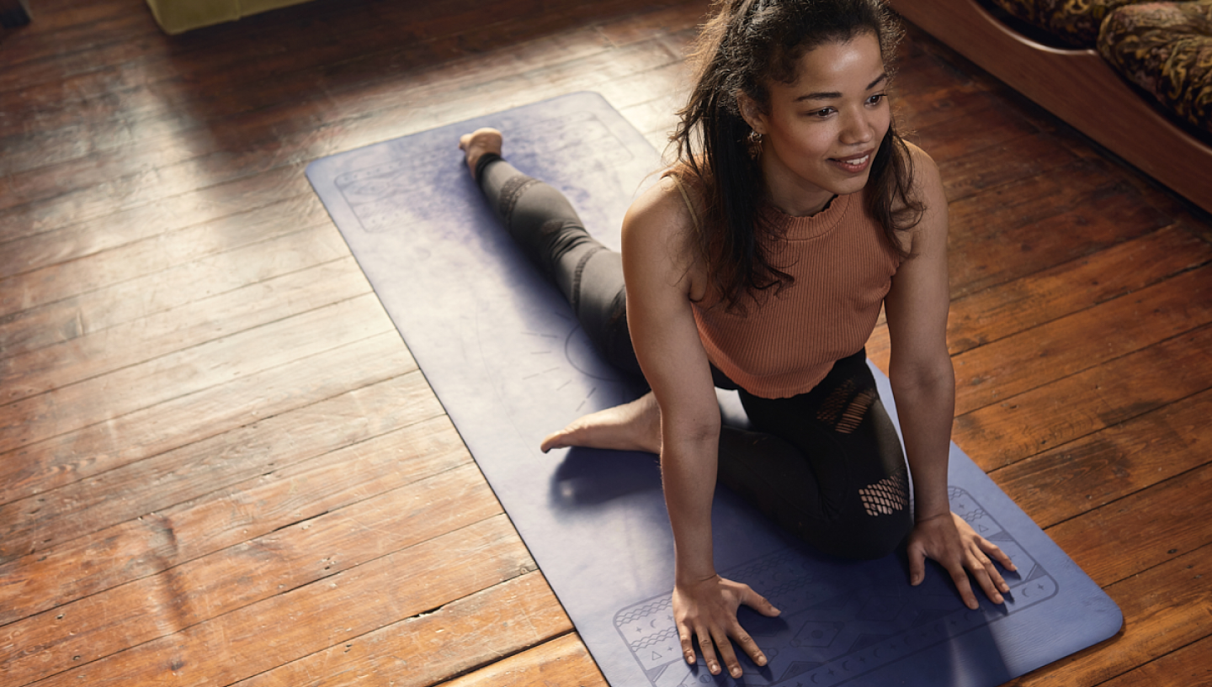




Positive Experiences For All People
Buddle.co
Notes:
For face to face

Slide 2
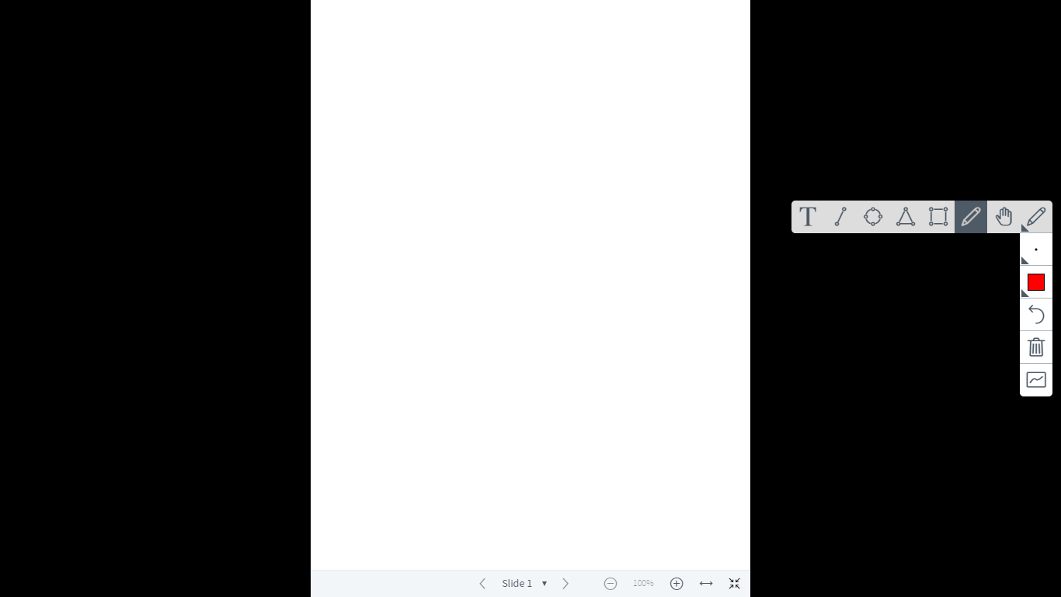


Use this doodle box to try the annotation tools whilst you wait.
You can find the annotation tools on the right of your screen
Welcome.
Your session will begin shortly.
Before we start, please ensure that:
If you are using social media, please tag: #Buddle, @SportEngland @SportStructures
Your microphone is muted
You can see and use the chat box
Buddle.co

Slide 3


A little about me…
… and you!
Add Tutor Picture
Add some info about you in the chat box:
- Your Club/Organisation Name
- Where you are based
- What you would like to gain from this workshop?
- Insert name
- Insert Experience
- My favourite …
Buddle.co

Slide 4

Learning Agreement
Respect everybody
Participate actively
Use technology responsibly
Be engaged
Challenge each other positively
Put phones on silent and return calls at an appropriate time
Avoid sharing any personal/sensitive information outside of the session
Buddle.co
Notes:
Please ask learners to consent to the delegate agreement using the chat box/mic etc
Participate actively - contribute to discussions and activities
Use technology responsibly - turning camera on, where possible, to build connections
Be engaged - limit distractions and maintain focus during the session

Slide 5
What we’ll cover:
By the end of this workshop, you will be able to:
Identify what constitutes a great participant experience
Review their current participant experience
Identify how to bring about change to positively influence the participant experience
Buddle.co

Slide 6

What is a great participant experience?
Buddle.co

Slide 7
Why is it a great participant experience?
#Fantastic
They make it so easy
Problems solved quickly
#Brilliant
I've been here for years
It’s like they know me
I can’t speak highly enough
Worth talking about
#BestClubInWiltshire
Buddle.co

Slide 8
Understanding the people in your organisation
Who do you want to attract and keep at your organisation?
What are their motivations for coming to your organisation?
What is important to them?
Who is missing?
1
Who are your people
2
How are you going to keep them?
3
Right experience
Consistently great
Buddle.co

Slide 9
Understanding your people
How do you consult with your members?
Buddle.co

Slide 10
Understanding your people
How do you consult with your members?
Depth
Focus groups
Breadth
Online/hardcopy surveys -
Satisfactions
Membership surveys
Individual interviews (informal and formal)
Club meeting/ AGMs/Townhalls/online open debates
Buddle.co

Slide 11
Understanding your people
What motivates people to be active?
Making money
Being successful
Success and goals
Time with friends and family
Weight loss/gain
Body image
Muscle Mass
Healthy
Making friends
Spending time
with
family/friends
Improving a
appearance
Learning new skills
Improving my CV
Gaining qualifications
Travel
Socialising
leisure
Time
Laugh/good times
Developing
myself
Having fun
Feeling good
Feeling healthy
De stress/ me time
Buddle.co

Slide 12
Understanding the people in your organisation
1
Who are your people?
Do you know what your people want?
Are you clear about your organisations offer?
Does your organisation offer meet what your people want?
If there are gaps between what people want and what you offer do you change your offer or change who you are targeting?
2
How are you going to keep them?
3
Right experience?
Buddle.co

Slide 13
Having the right offer for your participants
Success and goals
Time with friends and family
Improving a
appearance
Thinking about what your organisation offers... to what extent does it focus on, and deliver, each of the 6 factors?
Developing
myself
Having fun
Feeling good
Buddle.co

Slide 14
Understanding the people in your organisation
1
Who are your people?
2
How are you going to keep them?
Do you deliver the experience the people in your organisation want and expect?
3
Right experience?
Buddle.co

Slide 15
Delivering the right experience
What can you do before they take part
What can you do when they take part
What can you do after they take part?
The before, during and after…
Buddle.co

Slide 16
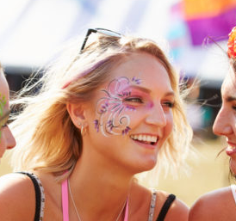
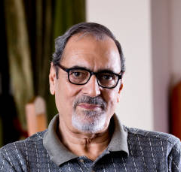


Meet…
Meet Darla
22 years old
Young image-conscious females keeping fit and trim.
Darla is 22 and student She shares a house with university friends who are also on students. Without the pressures of family or a mortgage, Chloe isn’t worried about her student loan, she likes to spend her income on clothes, nights out and holidays with friends. Chloe and her housemates go to classes at their local gym a couple of times a week and like to swim afterwards.
Meet Viraj
59 years old
Mid-life professional, sporty males with older children and more time for themselves.
Viraj is 55 an owner-occupier and married with two older children. Viraj keeps up his love of sport, hindered only by office pressures. He plays badminton in a local team, and if he gets home early enough, enjoys a swim at the health centre.
Buddle.co

Slide 17
Being Consistently Great
Continually seek feedback from your committee and act on it
Put the people at your organisation at the centre of everything you do
Continually seek feedback from people in your organisation and act on it
Have delivering a great organisation at the heart of what you do everyday
Make sure everyone is engaged with the organisation and each other including coaches, volunteers and committee
Make sure your volunteers know how to deliver a great organisation

Slide 18
Action Plan – what are you going to do now?
Who are your people?
Revisit why, providing a quality organisation experience is important to your organisation
Use the template to help you understand what actions you are going to undertake back at your organisation
What are the top 3 actions you are going to work on?
1
2
How are you going to keep them?
3
Right experience?
Buddle.co

Slide 19


Reflection
What will you take away from this session?
Any questions?
Please complete the evaluation
Good luck!
Buddle.co

Slide 20
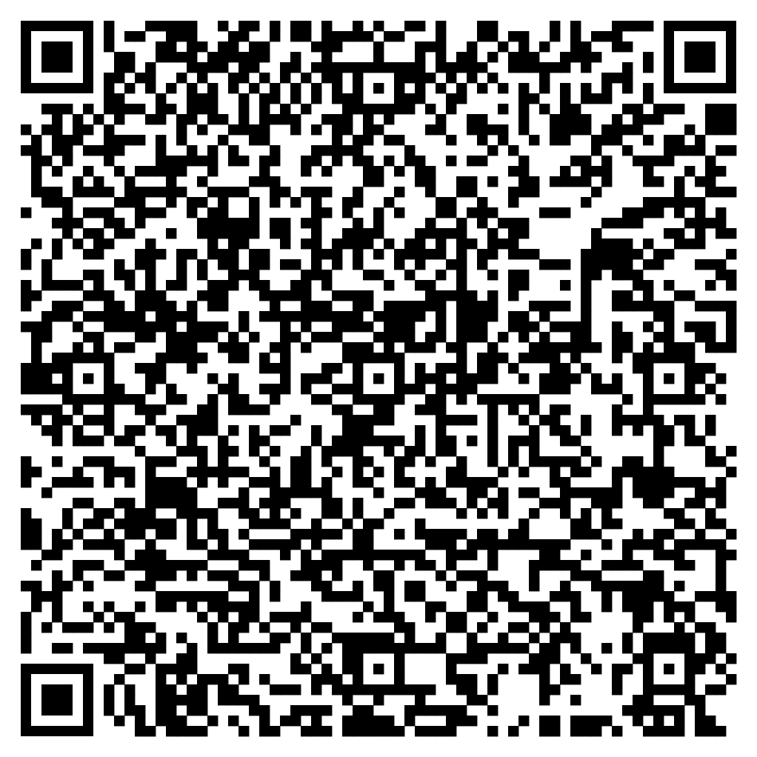





Feedback
Please take the time to fill in the evaluation survey by scanning the QR code.
Alternatively, the tutor will put the link in the chat box for you.
- Thanks in advance, the Buddle Team.

Slide 21
Recap:
By the end of this workshop, you will be able to:
Identify what constitutes a great participant experience
Review their current participant experience
Identify how to bring about change to positively influence the participant experience
Buddle.co

Slide 22

Buddle training
Getting Organised | Inclusion | Getting Help From People | Money Matters | Develop and Grow
Leadership and Your People | Your Culture and Values In Your Organisation | Maximising Your Volunteers Experience | Raising Money to Sustain Your Organisation | Promoting Your Offer Using Social Media
Exploring Legal Structures | Engaging different People |  | Financial Management | Creating a Marketing Strategy
Simply Planning | Positive Experiences For All People |  | Dealing With Increasing Costs | Engaging your community
See future dates at www.Buddle.co

Slide 23


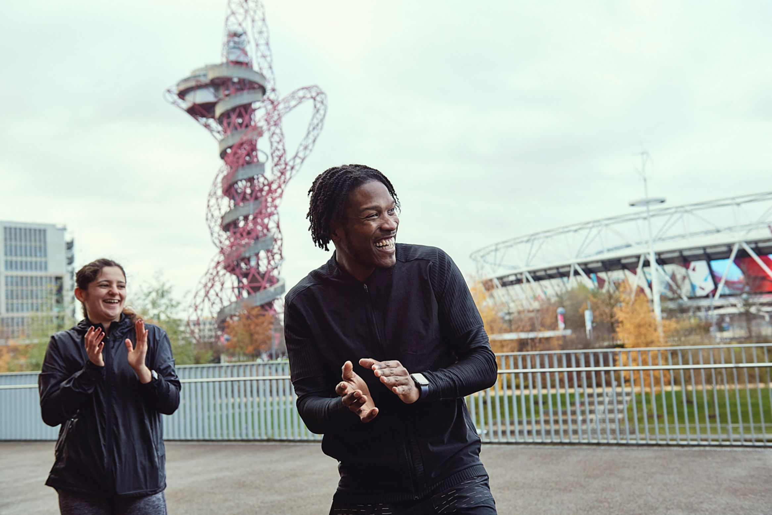
Thank you!
Buddle.co
Notes:
Title box: Click and drag the title box to resize, to allow for longer headings, or to fit around important areas of the image.
Image: To change the image, Right click / Control click on the image, select ‘Change picture… from file’.
Changing colours: Select the colour border area and apply a new shape fill from the Sport England Theme colours (please do not use the tints). Use the same colour for the border and the main title of the presentation.
Changing colours: Right click / control click the background, Select ‘Format background…’ Select a different fill colour from the Sport England Theme colours (please do not use the tints). Use the same colour for the border and the main title of the presentation.

