Slide 1
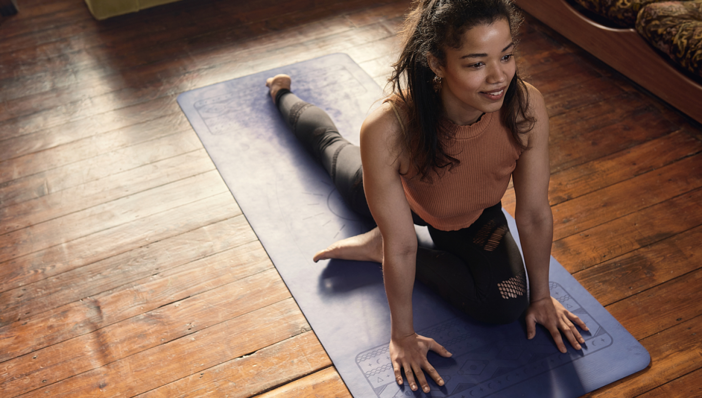




Maximising Your Volunteers Experience
Buddle.co

Slide 2



Use this doodle box to try the annotation tools whilst you wait.
You can find the annotation tools on the right of your screen
Welcome.
Your session will begin shortly.
Before we start, please ensure that:
If you are using social media, please tag: #Buddle, @SportEngland @SportStructures
Your microphone is muted
You can see and use the chat box
Buddle.co

Slide 3


A little about me…
… and you!
Add Tutor Picture
Add some info about you in the chat box:
- Your Club/Organisation Name
- Where you are based
- What you would like to gain from this workshop?
- Insert name
- Insert Experience
- My favourite …
Buddle.co

Slide 4

Learning Agreement
Respect everybody
Participate actively
Use technology responsibly
Be engaged
Challenge each other positively
Put phones on silent and return calls at an appropriate time
Avoid sharing any personal/sensitive information outside of the session
Buddle.co
Notes:
Please ask learners to consent to the delegate agreement using the chat box/mic etc
Participate actively - contribute to discussions and activities
Use technology responsibly - turning camera on, where possible, to build connections
Be engaged - limit distractions and maintain focus during the session

Slide 5
What we will cover
By the end of this workshop, delegates will be able to:
Develop a positive culture of volunteering within your organisation’s environment
Identify how to develop the volunteer’s experience
Identify top tips in recruiting, retaining and rewarding volunteers
Develop an action plan to improve their volunteer’s experience
Understand how to access further information to help improve the volunteer experience.
Notes:
Tutor guidance: mandatory slide
Title: Objectives
Timing: 2-3 mins
Type of Activity: Presentation
OBJECTIVE Go through each of the bullet points to set expectations.
Also mention expectation that participants share experiences, views, thought etc. Encourage the group to learn from each other

Slide 6
Culture
Artefacts
Behaviours
Values
Beliefs
What is your volunteering culture?
What sort of experience do you provide to your volunteers?
Notes:
Tutor guidance: mandatory slide
Title: Culture
Timing: 25 mins
Type of Activity: Presentation & Activities (page 5 & 6 of workbook)
Process:
What is culture?
The way of life, especially the general customs and beliefs, of a particular group of people at a particular time: youth/working-class culture.
Answer the following questions in the workbook (page 5):
What is your sports club culture?
Creation of a safe, welcoming and inclusive environment. Creating a positive image of the club. A place where people want to spend
What is your volunteering culture?
Everyone has a positive experience, everyone is rewarded, we don’t have a culture?
Activity 2 – Role Play:
Person 1
Plays the part of the volunteer (Mike, Jada or Rahul)
Play the part of this person, act like you think this person would act in this situation.
Person 2
Plays the part of finding out what the volunteer wants to do at the club
Match them to a position or role
Induct them into the role.
Activity 3:
Fill out the two columns on page 6 detailing:
The positives of your club and volunteering culture
The negatives of your club and volunteering culture
Encourage group/table discussions once these are filled in
Transition: Club culture

Slide 7
How would your volunteers describe their experience?
One definition…
“Understanding how an organisation interacts with its volunteers and how it motivates them to volunteer within the organisation”
What do we mean by volunteer experience?
How would your volunteers describe it?
Notes:
Tutor guidance: mandatory slide
Title: Your volunteers experience
Timing: 2 mins
Type of Activity: Presentation
Process:
How would your volunteers describe their experience?
Explain what is meant by volunteer experience.
Volunteer provides services for no financial gain
Transition: Culture

Slide 8






Have you thought about?
How open your messaging is?
How welcoming are you?
What your volunteers' motivations are?
How inclusive you are?
What your volunteers need?
Your communications
Notes:
Tutor guidance: Non-mandatory slide
Title: volunteering good practice
Timing: 2 mins
Type of Activity: Presentation
Process:
Recognize the changes you can make within your club and discuss each section
Open messaging
The welcome
Volunteer motivations 'inclusivity
Volunteer need
Communications
Transition: think about the motivations of your volunteers for the next slide

Slide 9
Why different people volunteer
Passionate about the sport
Meet new people
Put existing skills into practice or learn new skills
Step out of comfort zone and try something new
Enjoyment
Their children play in the team
Part of a University course
Notes:
Tutor guidance: Non-mandatory slide
Title: Motivation of volunteers
Timing: 2 mins
Type of Activity: Presentation
Process:
Discuss what motivates volunteers
Passionate about the sport
Meet new people
Put existing skills into practice or learn new skills
Step out of comfort zone and try something new
Enjoyment
Their children play in the team
Part of a University course
Transition: think about the motivations of your volunteers for the next slide

Slide 10
Organisation Culture
How do you create a welcoming and inclusive environment for your volunteers?
Is your approach organisation centric or volunteer centric?
Notes:
Tutor guidance: mandatory slide
Title: Club culture
Timing: 2 mins
Type of Activity: Presentation
Process:
Put learners into a breakout room for 2 minutes and discuss the two questions
How do you create a welcoming and inclusive environment for your volunteers?
If your approach, club centric or volunteer centric?
Get each group to feedback.
Transition: employed versus volunteer

Slide 11

Employed vs. Volunteer
Employed | Volunteer
Paid | Unpaid (may include expenses)
Job Description | Role Description
Contract of Employment | No Contract of Employment
Holiday & Sick pay | Can go on holiday whenever
Should volunteers be treated differently to employees?

Slide 12
When developing your volunteer culture…
Make it easy
Make it realistic
Make it fun
Make it inclusive
Notes:
Tutor guidance:
Title: when developing your volunteer culture
Timing: 5 mins
Type of Activity: Presentation
Process:
Consider the 4 factors
Make it easy
Make it realistic
Make it fun
Make it inclusive
Transition: break time

Slide 13
Break for 10 min Did you know…
Only 30% of people are looking for regular volunteering opportunities
Volunteer numbers in sport have dropped by more than 500,000 in last few years
We live in a fast-paced, demanding society - people are looking for opportunities which can fit with their lives, on the go.
Role of technology- this has changed, especially since the pandemic, with more organisations now using tech to support their operations and volunteers.
Volunteers in sport are more likely to quit than in other sectors because they don’t feel valued
Notes:
Slide that participants can read in their break

Slide 14
The volunteer experience Journey
Volunteers needs
Maintain and review role
outlines
identify training and mentoring
Identify tasks
Identify Tasks
Identify tasks
Identify key skills
Identify key skills
Organisation
Needs
Recruit
Retain
Club/org
Needs
Recruit
Retain
Recognise
Reward
Provide role outlines and identify volunteers with skills
Identify external organisations
Organise
Volunteer awards
Provide role outlines and identify volunteers with skills
Identify external organisations
Say,
THANK
YOU
Notes:
Tutor guidance: mandatory slide
Title: The volunteer experience journey
Timing: 5 mins
Type of Activity: Presentation
Process:
Walk through each stage of the volunteer journey:
Club needs – committee identifies tasks, identifies key skills at the club and those needed- but also highlight that volunteer needs as well.
Recruit – provide role outlines and identify volunteers with skills, and external organisations
Retain – maintain and review role outlines, identify training and mentoring
Recognise – organize volunteer awards, say thank you
Reward

Slide 15
Recruit, retain, recognise and reward
Recruit
Reward
Recognise
Retain
If you’re in a Breakout room that is an odd number, discuss…
If you’re in a Breakout room that is an even number, discuss…
Notes:
Tutor guidance: mandatory slide
Title: Recruit, retain, recognize and reward
Timing: 20 mins
Type of Activity: Presentation (notes page 8 of workbook)
& Activity (Page 9)
Process:
Put learners into two groups
Group 1- discuss recruit
Group 2- discuss retain
Bring learners back and get them to discuss their answers.
Transition- what is the difference between reward and regonise
Transition: Rethink volunteering roles

Slide 16
Recruit, retain, recognise and reward
Recruit
Reward
Recognise
Retain
What is the difference between…
Notes:
Tutor guidance: mandatory slide
Title: Recruit, retain, recognize and reward
Timing: 20 mins
Type of Activity: Presentation (notes page 8 of workbook)
& Activity (Page 9)
Process:
Again put learners into breakouts rooms or groups and get them to discuss the the difference between reward and regonise, ask them if they can come up with some examples of how they have applied this.
Transition: Rethink volunteering roles

Slide 17
Rethink volunteering roles
Regular help
Just a day
Just an hour
Just a
minute
Notes:
Tutor guidance: mandatory slide
Title: re think volunteering roles
Timing: 2 mins
Type of Activity: lecture.
Put the learners that volunteering is a philosophy and is not just once a week regular help- explain how its not all about regular help the following link may help with application https://bs3community.volunteermakers.org/get-involved/
Just a minute is that – its maybe piking up some litter after training
Just an hour – maybe serving teas and coffees at an event
Just a day – maybe serving bacon sandwiches at an event
Regular help maybe transporting kids every week to matches.
The tutor should try and use there own examples for there volunteering/working experience.
What do they think
Process:
Transition: Action Planning

Slide 18
Physiotherapist
1st Aid
Groundsman
General Maintenance
Secretary
Chairman
Treasurer
Team Managers
Fixtures Secretary
Coaches
Regular help
Just a day
Just an hour
Just
a minute
Volunteer coordinator
Referee/Official/
Umpire/ Scorer
Welfare Officer
Disability Officer
Fundraising and Sponsorship
Coaches
Caterer
Women and Girls Coordinator
Bar Manager
Junior Coordinator
Team Managers
Schools Liaison Officer
Events Coordinator
Social Secretary
Website Administrator
Developing and promoting the future of the organisation
Notes:
Tutor guidance: mandatory slide
Title: An example of a comprehensive club
Timing: 5 mins
Type of Activity: Presentation & Activity (Page 12)
Process:
All clubs are not like this
Activity: Choose two roles and discuss regular help. Just a day, just a minute volunteering
Transition: Roles and tasks

Slide 19
Roles and Tasks
Regular help
Just a day
Just an hour
Select one role from the previous slide and break them down into just a minute, just an hour, just a day and regular help tasks.
How could three volunteers do one role?
Just a minute
Notes:
Tutor guidance: mandatory slide
Title: Roles and tasks
Timing: 5 mins
Type of Activity: Presentation & Activity (page 13)
Process:
Choose three roles to break down into tasks
Transition: Role breakdowns

Slide 20

Example
Web site coordinator | Team managers
Maintain website with up to date content. | Weekly communication regarding selection lists and games.
Make a induction pack for volunteers and new members | Collect money to give to treasurer. Keep up to date team files
Design a logo | Arrange transport/ drive people to games
Take a photo of the team for the organisation website. | Collect kit and balls at the end of match/practice.
Regular help
Just a day
Just an hour
Just a
minute
Notes:
Tutor guidance: Non-mandatory slide
Title: Role breakdowns/ example
Timing: 3 mins
Type of Activity: Presentation/ lecture
Process:
show how both roles web site coordinator and team managers can be broken down into smaller chunk and tasks. Using the smaller chunk model presented
Transition: An amazing volunteer experience

Slide 21
Some Tips
When recruiting volunteers, match skills and roles to the person and think about your organisation culture.
Keep rewarding your volunteers. No matter how small or big the role, appreciate the time and effort they have given.
Ensure you recognise the hard work your volunteers have been doing by saying thank you.
Ensure volunteers are retained by inducting them properly and supporting them throughout their journey.
Keep offering feedback. Two-way communication is key. Offer CPD opportunities and let them make decisions.
Remember, keep its simple, make it realistic, make it inclusive and make it fun
Notes:
Tutor guidance: mandatory slide
Title: An amazing volunteer experience
Timing: 5 mins
Type of Activity: Presentation
Process:
Consider the 6 factors of an amazing volunteer experience
Transition: Action Planning

Slide 22
Action Planning
What is our volunteer experience like now?
What do we want our volunteer experience to look like?
How are we going to do it?
Notes:
Tutor guidance: mandatory slide
Title: Action planning
Timing: 5 mins
Type of Activity: Activity (page 14)
Process:
Answer the three questions in the workbook:
What is our volunteer experience like now?
What do we want our volunteer experience to look like?
How are we going to do it?
Transition: Reflections and actions

Slide 23


Reflection
What will you take away from this session?
Any questions?
Please complete the evaluation
Good luck!
Buddle.co

Slide 24
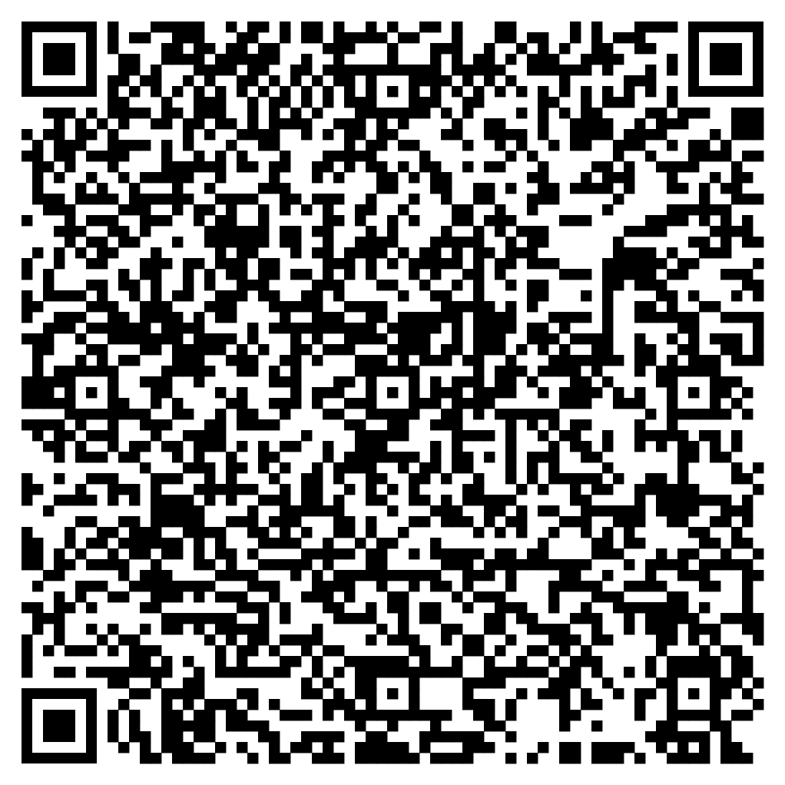





Feedback
Please take the time to fill in the evaluation survey by scanning the QR code.
Alternatively, the tutor will put the link in the chat box for you.
- Thanks in advance, the Buddle Team.

Slide 25
Recap:
By the end of this workshop, Learners will will be able to:
Develop a positive culture of volunteering within a organisation environment
Identify how to develop the volunteer’s experience
Identify top tips in recruiting, retaining and rewarding volunteers
Develop an action plan to improve their volunteer experience
Understand how to access further information to help improve the volunteer experience
Buddle.co

Slide 26

Buddle training
Getting Organised | Inclusion | Getting Help From People | Money Matters | Develop and Grow
Leadership and Your People | Your Culture and Values In Your Organisation | Maximising Your Volunteers Experience | Raising Money to Sustain Your Organisation | Promoting Your Offer Using Social Media
Exploring Legal Structures | Engaging different People |  | Financial Management | Creating a Marketing Strategy
Simply Planning | Positive Experiences For All People |  | Dealing With Increasing Costs | Engaging your community
See future dates at www.Buddle.co

Slide 27


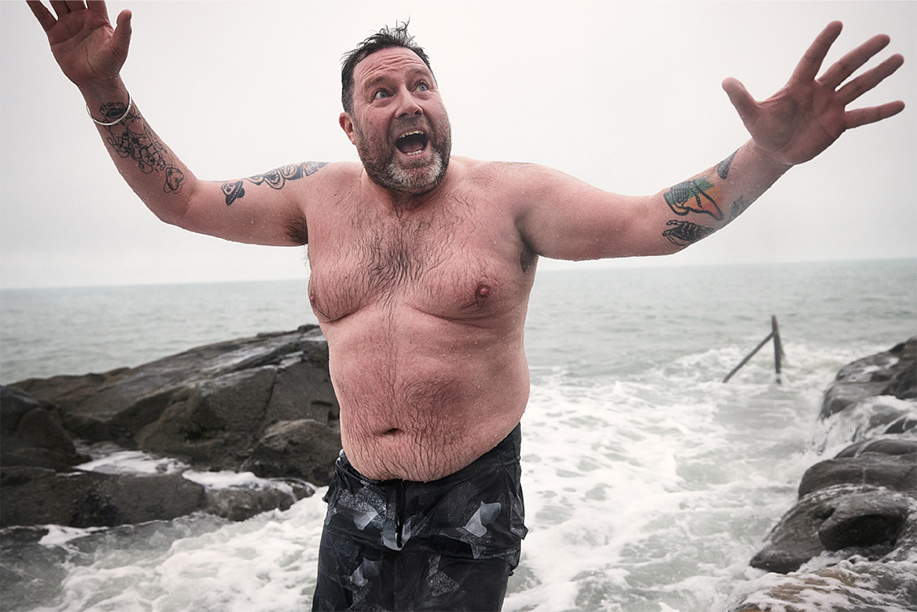

Thank you!
Notes:
Title box: Click and drag the title box to resize, to allow for longer headings, or to fit around important areas of the image.
Image: To change the image, Right click / Control click on the image, select ‘Change picture… from file’.
Changing colours: Select the colour border area and apply a new shape fill from the Sport England Theme colours (please do not use the tints). Use the same colour for the border and the main title of the presentation.
Changing colours: Right click / control click the background, Select ‘Format background…’ Select a different fill colour from the Sport England Theme colours (please do not use the tints). Use the same colour for the border and the main title of the presentation.

