Slide 1





Dealing with increasing costs
Buddle.co

Slide 2


While you are waiting – type in the chat box...
Where are you in England?
Which community organisation / club are you representing?
Have you attended Club Matters training before?
Welcome. Your session will begin shortly.
Before we start, please ensure that:
If you are using social media, please tag: #Buddle, @SportEngland @SportStructures
Your microphone is muted
You can see and use the chat box
Buddle.co

Slide 3


A little about me…
… and you!
Add Tutor Picture
Add some info about you in the chat box:
- Your Club/Organisation Name
- Where you are based
- What would you like to gain from this workshop?
- Insert name
- Insert Experience
- My favourite …
Buddle.co

Slide 4

Learning Agreement
Respect everybody
Participate actively
Use technology responsibly
Be engaged
Challenge each other positively
Put phones on silent and return calls at an appropriate time
Avoid sharing any personal/sensitive information outside of the session
Buddle.co
Notes:
Please ask learners to consent to the delegate agreement using the chat box/mic etc
Participate actively - contribute to discussions and activities
Use technology responsibly - turning camera on, where possible, to build connections
Be engaged - limit distractions and maintain focus during the session

Slide 5

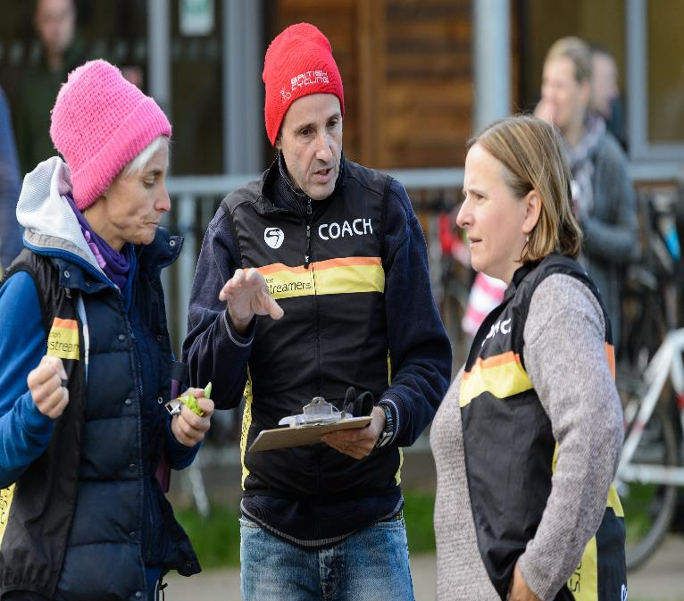
What we’ll cover:
By the end of this workshop, you will be able to:
Explore the potential impact the cost-of-living increases are having on clubs and community organisations.
Share learning on what organisations have been doing to counterbalance this.
Signpost to tips, hints and other sources of information.
Buddle.co

Slide 6
Cost of Living explained
Why are we experiencing these challenges?
Financial legacy of the Covid-19 pandemic
Conflict in Ukraine and associated economic sanctions
Global supply chain issues
Other global instability
Inflation, tax rises and wage stagnation
Buddle.co

Slide 7


What we know – cost of living and physical activity
39% of people (across all groups) agree the cost-of-living increase has had a negative impact on their ability to be active.
13% say they are spending less on physical activity.
53% think the cost of living will eventually have a negative impact on their ability to be active going forwards.
Based on Sport England's cost of living research there are some key considerations;
1. Cost – sport & physical activity isn't considered an essential spend
2. Transport & travel - 43% of people with less disposable income say they are spending less money on travel than they did a year ago.

Slide 8

We know clubs and community organisations are concerned - Facility Owners
Organisations that lease (77%) or own (81%) facilities reported concern around the challenges of increased utility costs.
For sessional (71%) and long-term renters (52%) increases in hire cost were the most commonly cited challenges.
Most clubs and community organisations have seen increases of up to 50% percent in their facility costs.
All clubs and community organisations said that 50% of young people are struggling to afford fees.
Buddle.co

Slide 9
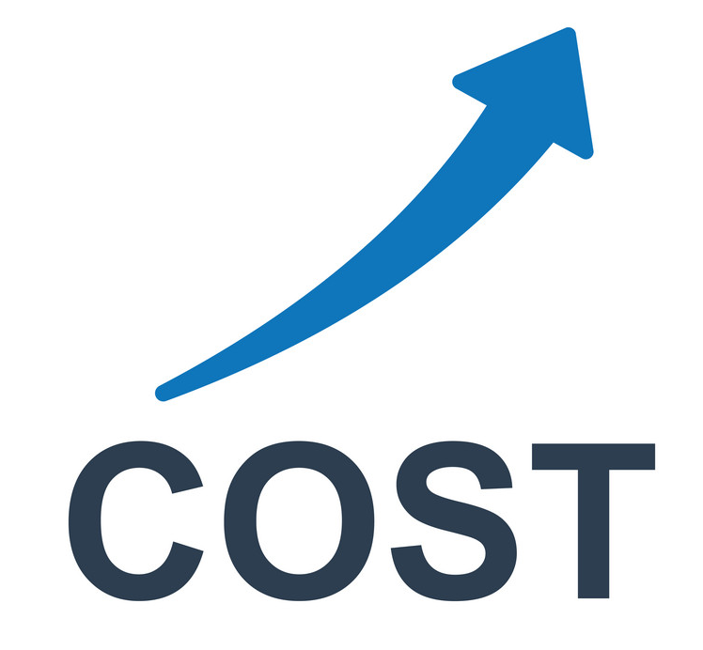
Share and learn - the Costs
Rent or hire of buildings and facilities e.g., pitches
Food and subsidence
Tax
Everyday items (clothing, kit)
Transport
Energy (gas and electric)
Legal (insurance etc)
Other costs
Buddle.co

Slide 10
We know clubs and community organisations are concerned - General
97% of respondents are concerned (extremely/fairly) about the impact of Cost of Living rises on organisations.
94% are concerned about the effects on young people.
41% have seen a reduction in financial support locally – Businesses/ individuals – local trusts and foundations.
41% need £10k or more to support Cost of Living priorities over next 6 months.
67% indicated that up to half of their young people won’t be able to attend activities over the next 6 months because of Cost-of-Living pressures.
Buddle.co

Slide 11

Talk and share – the issues
How are the rises in the cost of living affecting your clubs or community organisation?
What are you seeing/hearing?
Cost of goods
Utilities
Hire costs, rents etc
Financial impact
Buddle.co

Slide 12

Share and learn–the action…
How is your club or organisation responding to the cost-of-living situation?
What action are you taking to offset these costs?
What has been the result of this action?
Buddle.co

Slide 13
Actions - TIPS for asset and non asset owning
Reduce the number of sessions
Use a cheaper/ smaller venue/ use 1/3rd of pitch for training
Share transport-carshare for away/ home games
Source/ tender out for kit suppliers
Grants and fundraising
Renegotiate insurance/ change supplier
Renegotiate catering/ change supplier
Switch the lights off
Buddle.co

Slide 14


Share and learn – example 1
“
Mansfield Town FC - EFL Division 2
MANSFIELD have brought forward their kick-off a home League Two game against Walsall in a bid to tackle escalating energy costs. The fixture was originally scheduled for 3pm but will now kick off at 1pm as the Stags bid “to mitigate the forthcoming, considerable increase in energy bills”.
The club said:
As part of these efforts, the earlier kick-off time will enable the club to discern whether significant savings can be made on floodlight usage and other energy costs.”
- Source: Morning star
Buddle.co

Slide 15


Share and learn – example 2
“
Cromer Tennis and Squash club - Grassroots.
The club said it was trying to be more imaginative in increasing its membership - including cutting playing fees in half for the next seven months.
We felt we just had to cut our prices by half for the rest of our membership year if we were going to attract any members at all.”
"It is incredibly tough because this particular area is a low-income area," he said, adding that some parents had been struggling to afford the fees. "It is a really sad story when they can't do that so we have got to reduce prices to get them on the tennis court.”
Kelvin van Hasselt,
Club Chairman
Buddle.co

Slide 16


Share and learn: Membership fees versus subsidisation
Membership fees increase
If you have increased your fees, how have you done this?
How much revenue has this generated?
Has it impacted your membership?
What support have you put in to support members that can't afford the uplift?
Paused. Not increased fee increase
If you haven't increased fees, what has prevented you from doing this?
How are you funding this subsidisation?
Has it impacted your membership?
What support have you put in to support members that can't afford membership/fees?
Buddle.co

Slide 17
Share and learn – support
What help and support are you receiving to support the increases in cost?
Are you working with other organisations?
What support do you need?
Buddle.co

Slide 18
Grants/fundraising
ASDA Foundation Cost of Living Fund
  Supports projects under four themes:
    Building Resilient Communities,
    Active Lives,
    Seasonal Celebrations & Festivals,
    Leading Healthier Lives.
  The grant amount is between £500 and £1500.
  Help those with rising cost of living and to support refugees.
  The application window is 19th September 2022 to February 2023 and will close as soon as the budget cap is reached.
  https://www.asdafoundation.org/foundation-grants
Sport England, Active Together Fund
  A £7.5 million lottery fund with grants of up to £10,000
  To help reduce the negative impact of cost of living rises and Covid-19 pandemic
  For community groups working to help more people be active
  Closing date for applications is 31st October 2022
  Projects to be delivered by 31st March 2023
  https://www.sportengland.org/funds-and-campaigns/our-funds/active-together

Slide 19
Grants/fundraising
Aviva Community Fund
  Offers an additional £2 million in match funding for causes supporting financial wellbeing in their communities across the UK.
  Aviva has teamed up with the fundraising platform Crowdfunder.
  Aviva will match each donation given by the general public, up to the value of £250 between the 4th October 2022 and 31st December 2022, or until the entire £2 million is allocated.
  A maximum of £50,000 of match funding is available per organisation.
  https://www.aviva.co.uk/services/more-from-aviva/aviva-community-fund/
Groundwork: One Stop Community Partnership Programme
  Designed to support community groups or organisations operating within two miles of One Stop stores who are:
    tackling food poverty,
    supporting the vulnerable, elderly, low-income families and
    running youth sports teams.
  This grant is up to £1,000 and applications can be received at any time.
  https://www.groundwork.org.uk/one-stop-community-partnership/

Slide 20
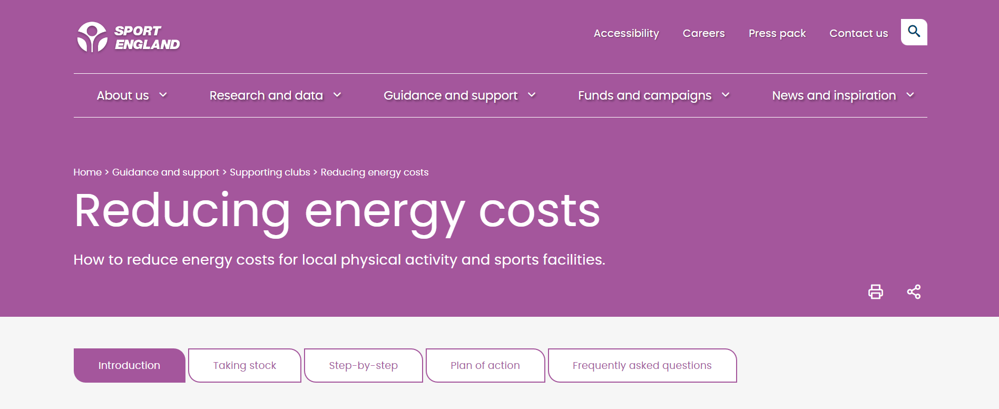
New Sport England guidance
Buddle.co

Slide 21


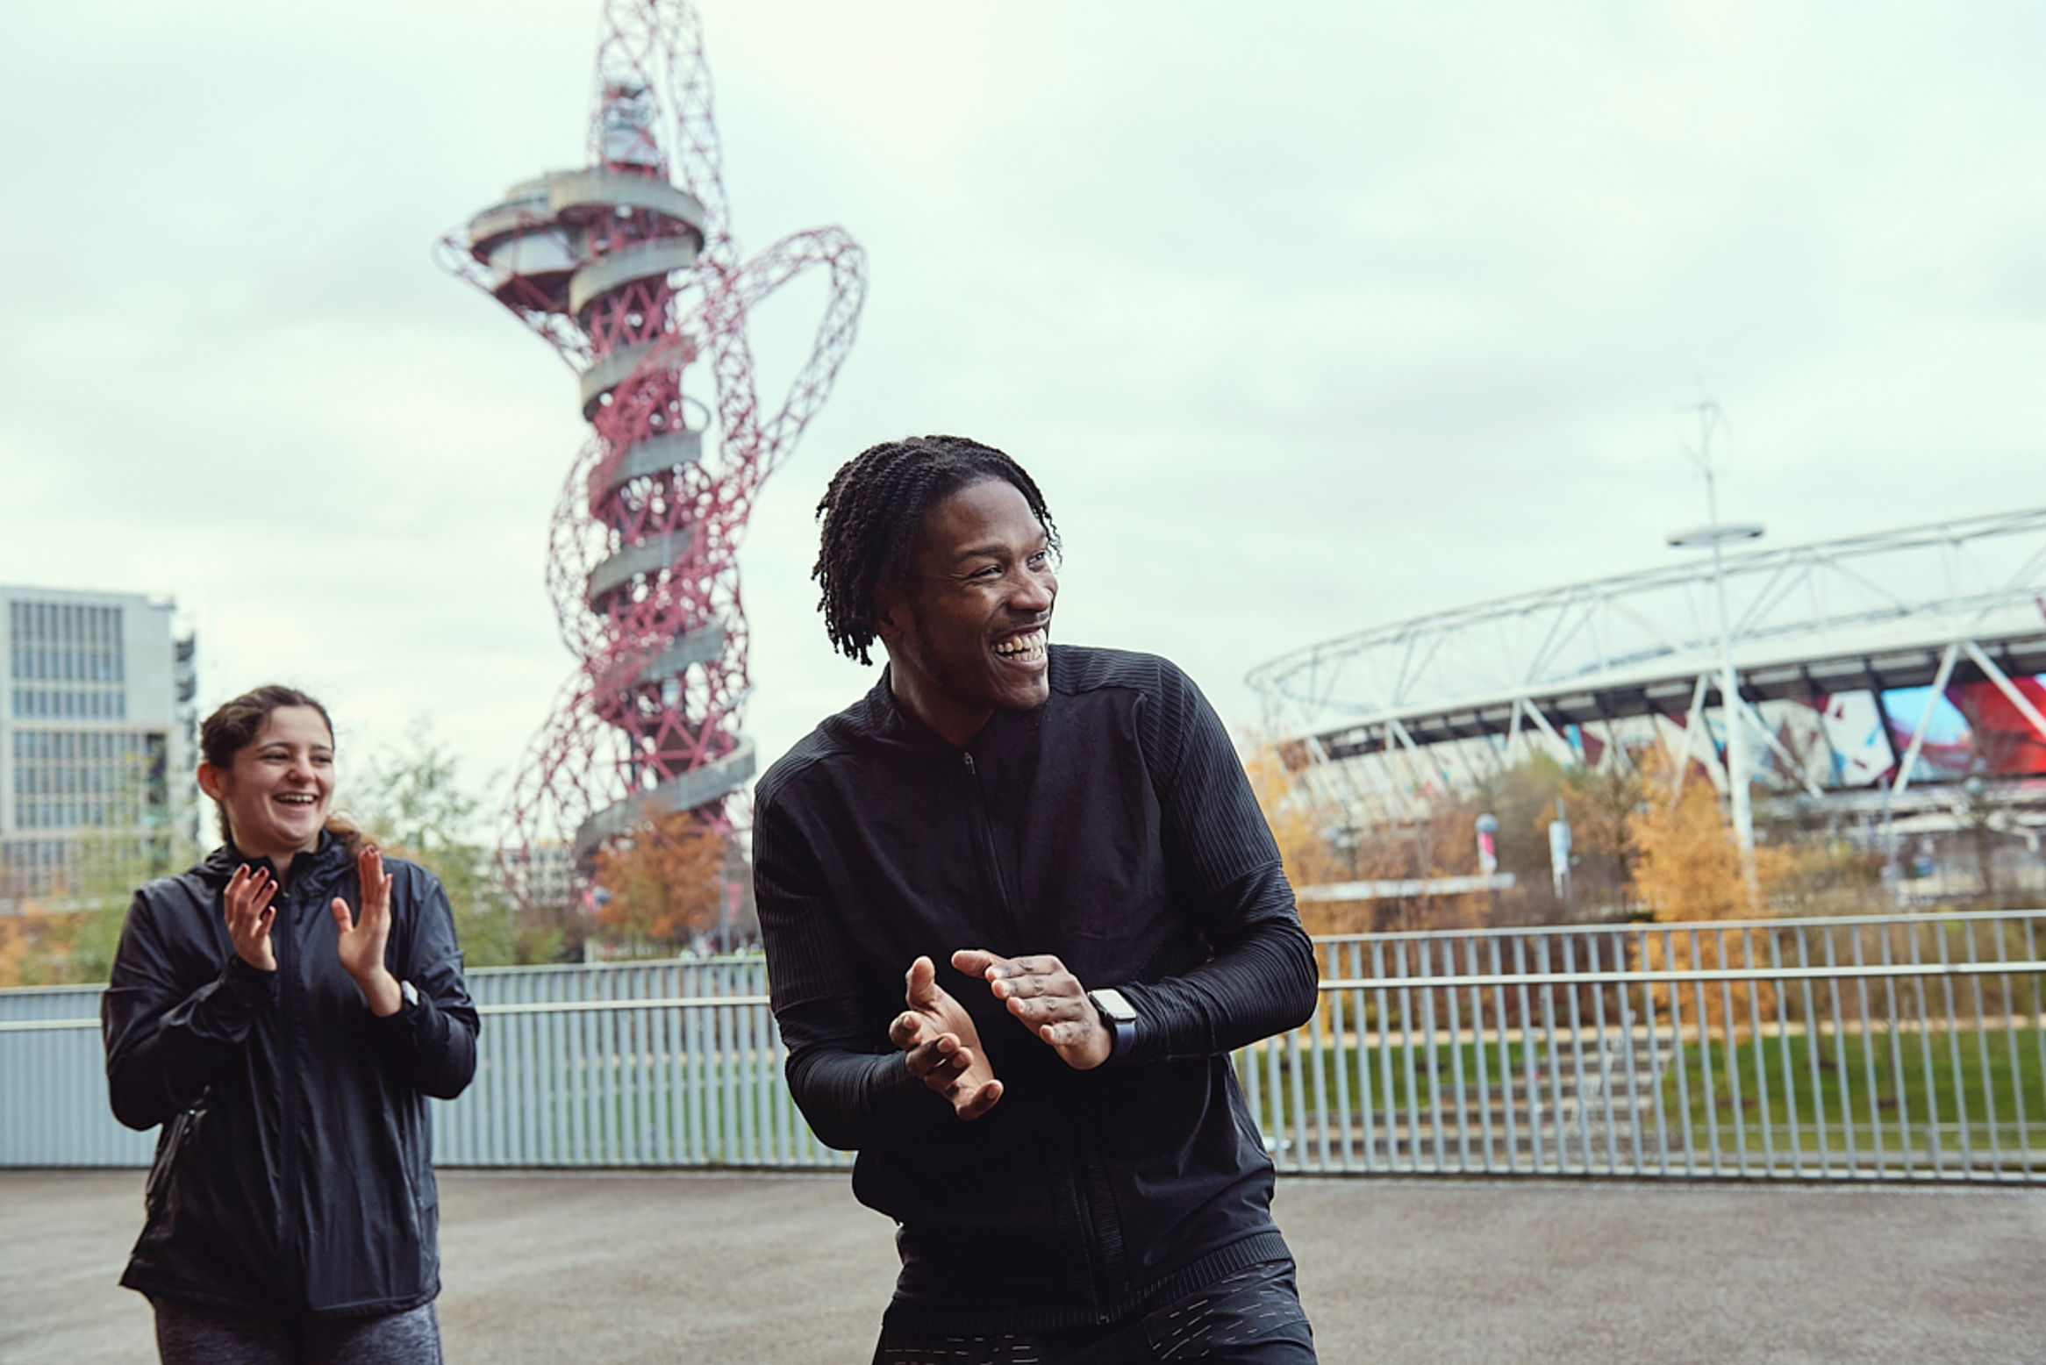
Asset owning content only

Slide 22
Asset owning –TIPS- Hot water and heating
Are you overheating your facility?
Control hot water temperatures – reduce the heat (60 degree)
Don’t let heat escape -insulate
Ensure boiler are on a timer and set these timers to match the building use
Keep heaters clear
Heater boiler turn off in summer
Draught proof doors and windows
Buddle.co

Slide 23
Asset owning – TIPS- Lighting
Switch on to switching off - Put posters and visual aids to remind people to turn off lights
Reduce unnecessary lighting
Automate lighting in little used areas
Install daylight sensors
Change to LED lightening where possible
Use natural light – let the sunshine in
Take control of car park lighting
Right thermostat -right place
Insulate pipework
Install TRVS

Slide 24
Asset owning - club's cellars and bars
Insulation and door management - Insulate your cellar walls - Add items such as strip curtains and door gaskets to prevent warm air from permeating the cellar
Removing fridges and ice machines - Where possible, remove fridges and ice machines from cellars N/A Turn off bar fridges between uses - Turn off bar fridges when there is several days between uses - Install 7-day timer plugs on bar fridges
Install a thermostat in your cellar - Regularly check the temperature and settings
Free cooling systems - Cellars should be kept between 10 – 13 C - Consider professionally installing “freecooling” system.
Buddle.co

Slide 25
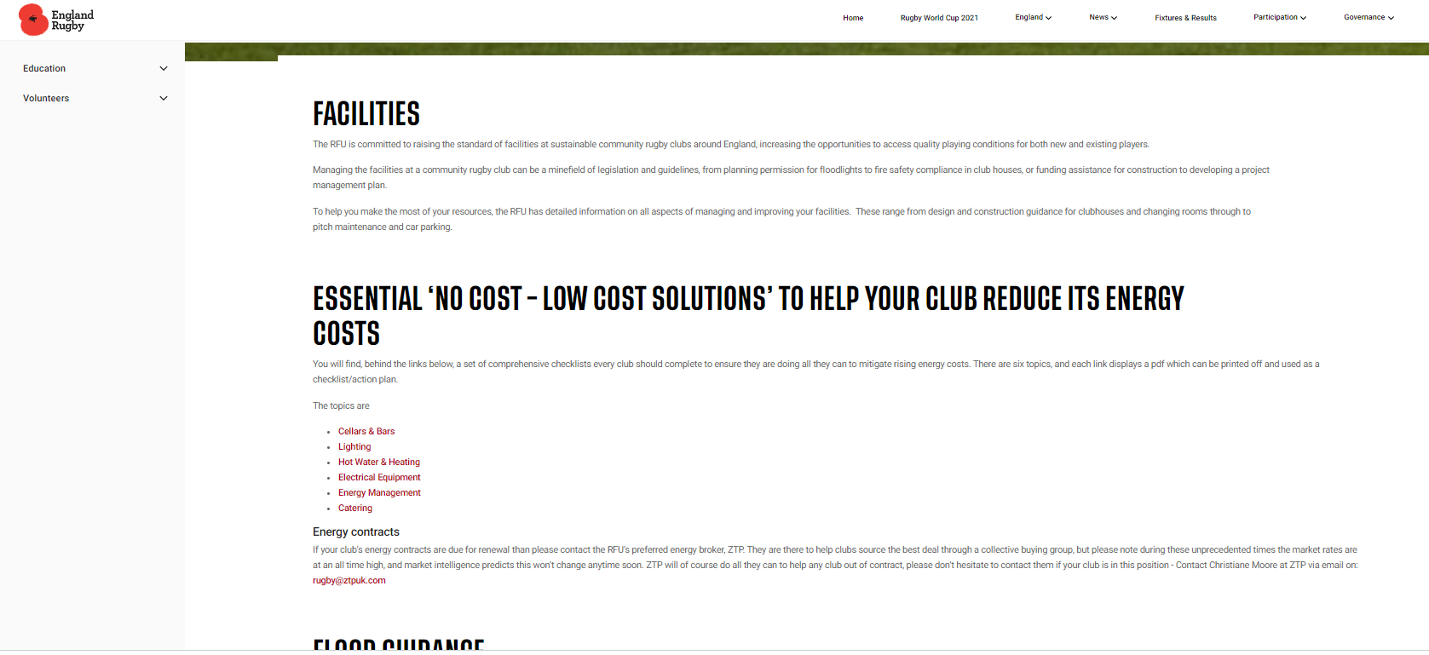
RFU guidance to reduce energy costs…
Buddle.co

Slide 26
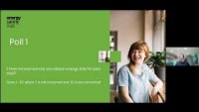
Asset owning – Energy Saving Trust Webinar - RFU
Buddle.co

Slide 27
Recap:
Explore the potential impact the cost-of-living increases are having on clubs and community organisations.
Share learning on what organisations have been doing to counterbalance the cost-of-living increases and what support they are accessing.
Signpost to tips, hints and other sources of information to support with cost-of-living increases.
Buddle.co

Slide 28


Reflection
What will you take away from this session?
Any questions?
Please complete the evaluation
Good luck!
Buddle.co

Slide 29
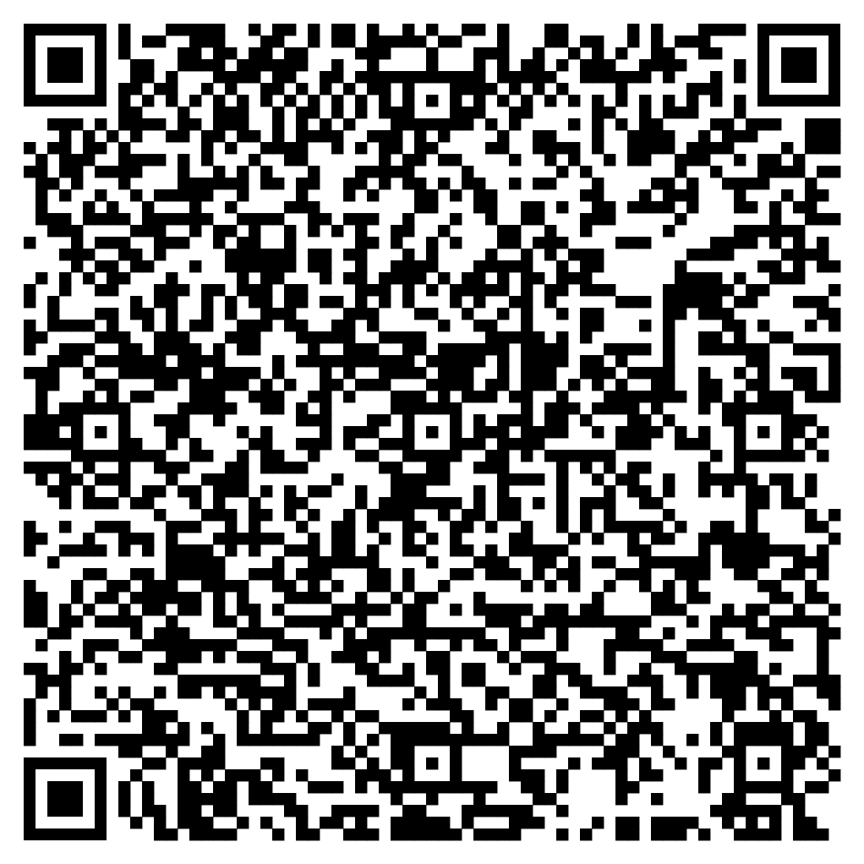





Feedback
Please take the time to fill in the evaluation survey by scanning the QR code.
Alternatively, the tutor will put the link in the chat box for you.
- Thanks in advance, the Buddle Team.

Slide 30

Buddle training
Getting Organised | Inclusion | Getting Help From People | Money Matters | Develop and Grow
Leadership and Your People | Your Culture and Values In Your Organisation | Maximising Your Volunteers Experience | Raising Money to Sustain Your Organisation | Promoting Your Offer Using Social Media
Exploring Legal Structures | Engaging different People |  | Financial Management | Creating a Marketing Strategy
Simply Planning | Positive Experiences For All People |  | Dealing With Increasing Costs | Engaging your community
See future dates at www.Buddle.co

Slide 31
Thank you!
Buddle.co
Notes:
Title box: Click and drag the title box to resize, to allow for longer headings, or to fit around important areas of the image.
Image: To change the image, Right click / Control click on the image, select ‘Change picture… from file’.
Changing colours: Select the colour border area and apply a new shape fill from the Sport England Theme colours (please do not use the tints). Use the same colour for the border and the main title of the presentation.
Changing colours: Right click / control click the background, Select ‘Format background…’ Select a different fill colour from the Sport England Theme colours (please do not use the tints). Use the same colour for the border and the main title of the presentation.

