Slide 1





Engaging Your Communities
Buddle.co

Slide 2



Use this doodle box to try the annotation tools whilst you wait.
You can find the annotation tools on the right of your screen
Welcome.
Your session will begin shortly.
Before we start, please ensure that:
If you are using social media, please tag: #Buddle, @SportEngland @SportStructures
Your microphone is muted
You can see and use the chat box
Buddle.co

Slide 3


A little about me…
… and you!
Add Tutor Picture
Add some info about you in the chat
- Your Club/Organisation Name
- Where you are based
- What you would like to gain from this workshop?
- Jo Pilgrim
- Senior Consultant Sport Structures
-
Buddle.co

Slide 4

Learning Agreement
Respect everybody
Participate actively
Use technology responsibly
Be engaged
Challenge each other positively
Put phones on silent and return calls at an appropriate time
Avoid sharing any personal/sensitive information outside of the session
Buddle.co
Notes:
Please ask learners to consent to the delegate agreement using the chat box/mic etc
Participate actively - contribute to discussions and activities
Use technology responsibly - turning camera on, where possible, to build connections
Be engaged - limit distractions and maintain focus during the session

Slide 5
What we’ll cover:
By the end of this workshop, you will be able to:
Understand the principles of community engagement
Explore the benefits of community engagement for both the organisation and the community
Explore how their organisation can meet the needs of the local community and identified how to engage with their community
Identify actions to improve your organisation’s community engagement and increase participation
Buddle.co

Slide 6
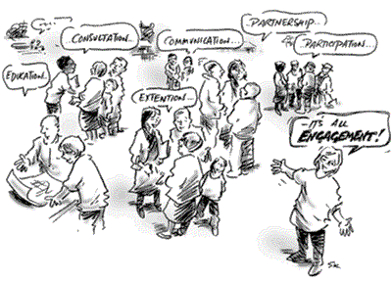
Community Engagement
What does community engagement mean to you ?
What does it mean to your orginsation
Buddle.co

Slide 7
Community Engagement
A process that builds a strong and ongoing relationship between an organisation and an identified ‘community’ to apply a collective vision for the benefit of the community and organisation
Buddle.co

Slide 8
What do you think are some of the key principles for Community Engagement?
Buddle.co

Slide 9
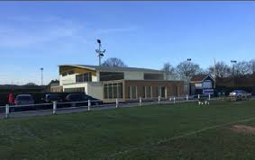
Community Engagement Principles
Memberships reflects the diverse community they are aiming to represent
Community is engaged and empowered to get involved and support the organisation
Community is consulted on the offer / service
Community is informed of how they have contributed to decision making
Seeks input from the community to inform decision making
Diversity of thought – the organisation committee is reflective of the community and include people who are thinking out of the box
Organisation makes decisions based on the needs and interests of community members
Buddle.co
9

Slide 10
So what? ... The benefits
What are the possible benefits for my organisation? | What are the possible benefits for my local or an identified community?
Buddle.co

Slide 11

Wigan St Judes have worked with their community to maximise their facilities …
Buddle.co

Slide 12
Does your organisation reflect the community that surrounds it?
Who are your communities?
Buddle.co

Slide 13
Ideas for community engagement
Get creative, get thinking… what are your ideas to engage with your organisation’s community?
Remember to think about:
What are the mutual benefits and purpose?
The principles of community engagement?
Who is in your community?
What organisations could you work with?
Buddle.co

Slide 14
Utilising community organisations to reach new communities
Civic political group
Housing associations
Job related groups
Health based
Other voluntary run sports organisations doing community engagement
Volunteer groups
Charities and non-profit-making organisations
Local businesses
Education
Youth and uniformed groups.
Faith based groups
Arts based organisations
General recreation groups
Buddle.co

Slide 15
Community engagement activities
Capacity building
Community research
Direct service
Sharing skills
Become part of the ecosystem of community engagement activities
Sport social prescribing
Indirect service
Fundraising
Participation in association
Advocacy and education
Buddle.co

Slide 16
Process for community engagement
Inform
Consult
Involve
Collaborate
Empower
Review your current organisation offer and consult with existing membership
Research your community
Appoint a community lead / leads
Consult/ build dialogue with your community
Listen to feedback
Build relationship
Make changes to organisation offer
Examples
Buddle.co

Slide 17
Examples:
Example 1: Membership is consulted, and concerns are raised about the number of young people that don’t attend the organisation, even though there is a junior section
Example 2: Local research shows there is a large population of young people (two high schools and 7 primary schools). High crime and anti-sociable behaviour compared to regional averages
Example 3: Member is a French teacher at a local school. They believe they are best placed to engage with school and the wider community as she is already recognised by parents and the wider community.
Buddle.co

Slide 18
Examples:
Example 4: Organisation decide they are going to try and engage with one high school and 3 primary school. Other members of organisation are going to try and engage and seek thoughts form local business owner
Example 5: High School wants to tackle anti-social behaviour around the school and the local leisure centre. Local businesses are also concerned about this.
Example 6: Continue to build relationship with school, keep in touch and let them know what is happening. Organisation, school and local business agree to fundraise for a sports programme for young people.
Example 7: Decide they are going to invest and upskill including recruiting volunteers from the local community. Organisation create a programme that directly tackles the anti social behaviour issues and crime in the area, and resource through fundraising and Sport England.
Buddle.co

Slide 19
Lessons from Boxing Best Practice
Location, location, location – focal point
Organisation leaders know and understand the issues faced by local people every day
Create a welcoming environment
Organisation culture of respect, commitment and positive behaviour
Support the whole participant – not just the athlete
Reach out to marginalised groups
Work with a range of community partners.
Buddle.co

Slide 20
Top tips for better community engagement
Ensure that your community engagement is linked to the culture, ethos, and values of the organisation and isn’t just an add on
Listen, to your community … and then listen some more.
Make changes to your organisation offer as the community changes- listen to the feedback
Do what you say you are going to do and show people you have made these changes.
Relate to people, business, local organisations and understand that communities are diverse.
Buddle.co

Slide 21
Action plan for community engagement
Where are we now regarding community engagement?
Where do we want to be?
How are we going to get there? What actions are we going to take?
How will this increase participation/volunteering?
How many contacts to you have?
How many partnerships?
What is the community perception of the organisation?
What are the potential benefits in changing the organisation’s approach to community engagement?
Community engagement mission statement?
Number of positive relationship you would like?
Number of partners?
Increased community viability and visibility?
For example:
write a strategy
do some local research
consult the community
Contact local groups
Attend local events
Look at each of the actions - will it truly increase participation ? If so, how?
If no, why, and does it need to be on your plan?
Buddle.co

Slide 22
https://www.youtube.com/watch?v=krukc_GDJVY
Buddle.co

Slide 23


Reflection
What will you take away from this session?
Any questions?
Please complete the evaluation
Good luck!
Buddle.co

Slide 24
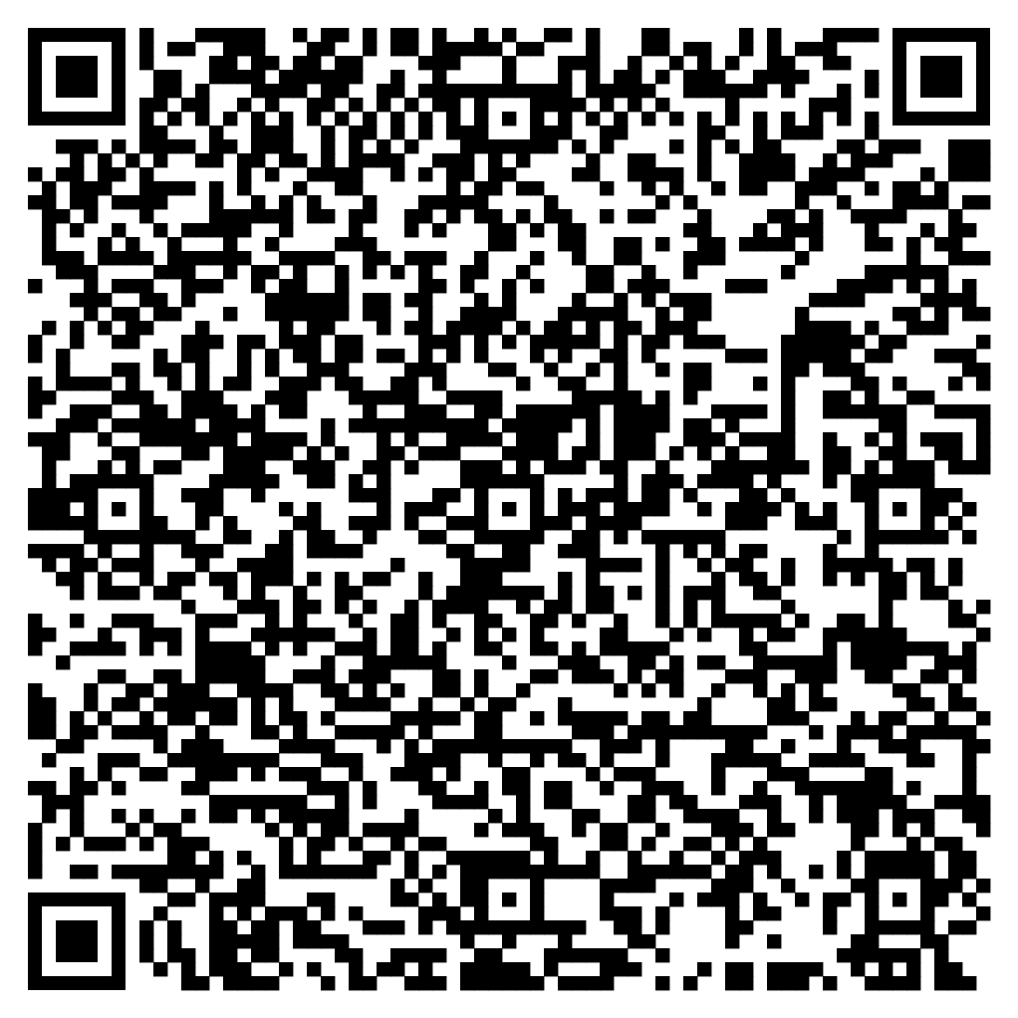





Feedback
Please take the time to fill in the evaluation survey by scanning the QR code.
Alternatively, the tutor will put the link in the chat box for you.
- Thanks in advance, the Buddle Team.

Slide 25
Recap:
By the end of this workshop, you will be able to:
Understand the principles of community engagement
Explore the benefits of community engagement for both the organisation and the community
Explore how their organisation can meet the needs of the local community and identified how to engage with their community
Identify actions to improve your organisation’s community engagement and increase participation
Buddle.co

Slide 26

Buddle training
Getting Organised | Inclusion | Getting Help From People | Money Matters | Develop and Grow
Leadership and Your People | Your Culture and Values In Your Organisation | Maximising Your Volunteers Experience | Raising Money to Sustain Your Organisation | Promoting Your Offer Using Social Media
Exploring Legal Structures | Engaging different People |  | Financial Management | Creating a Marketing Strategy
Simply Planning | Positive Experiences For All People |  | Dealing With Increasing Costs | Engaging your community
See future dates at www.Buddle.co

Slide 27


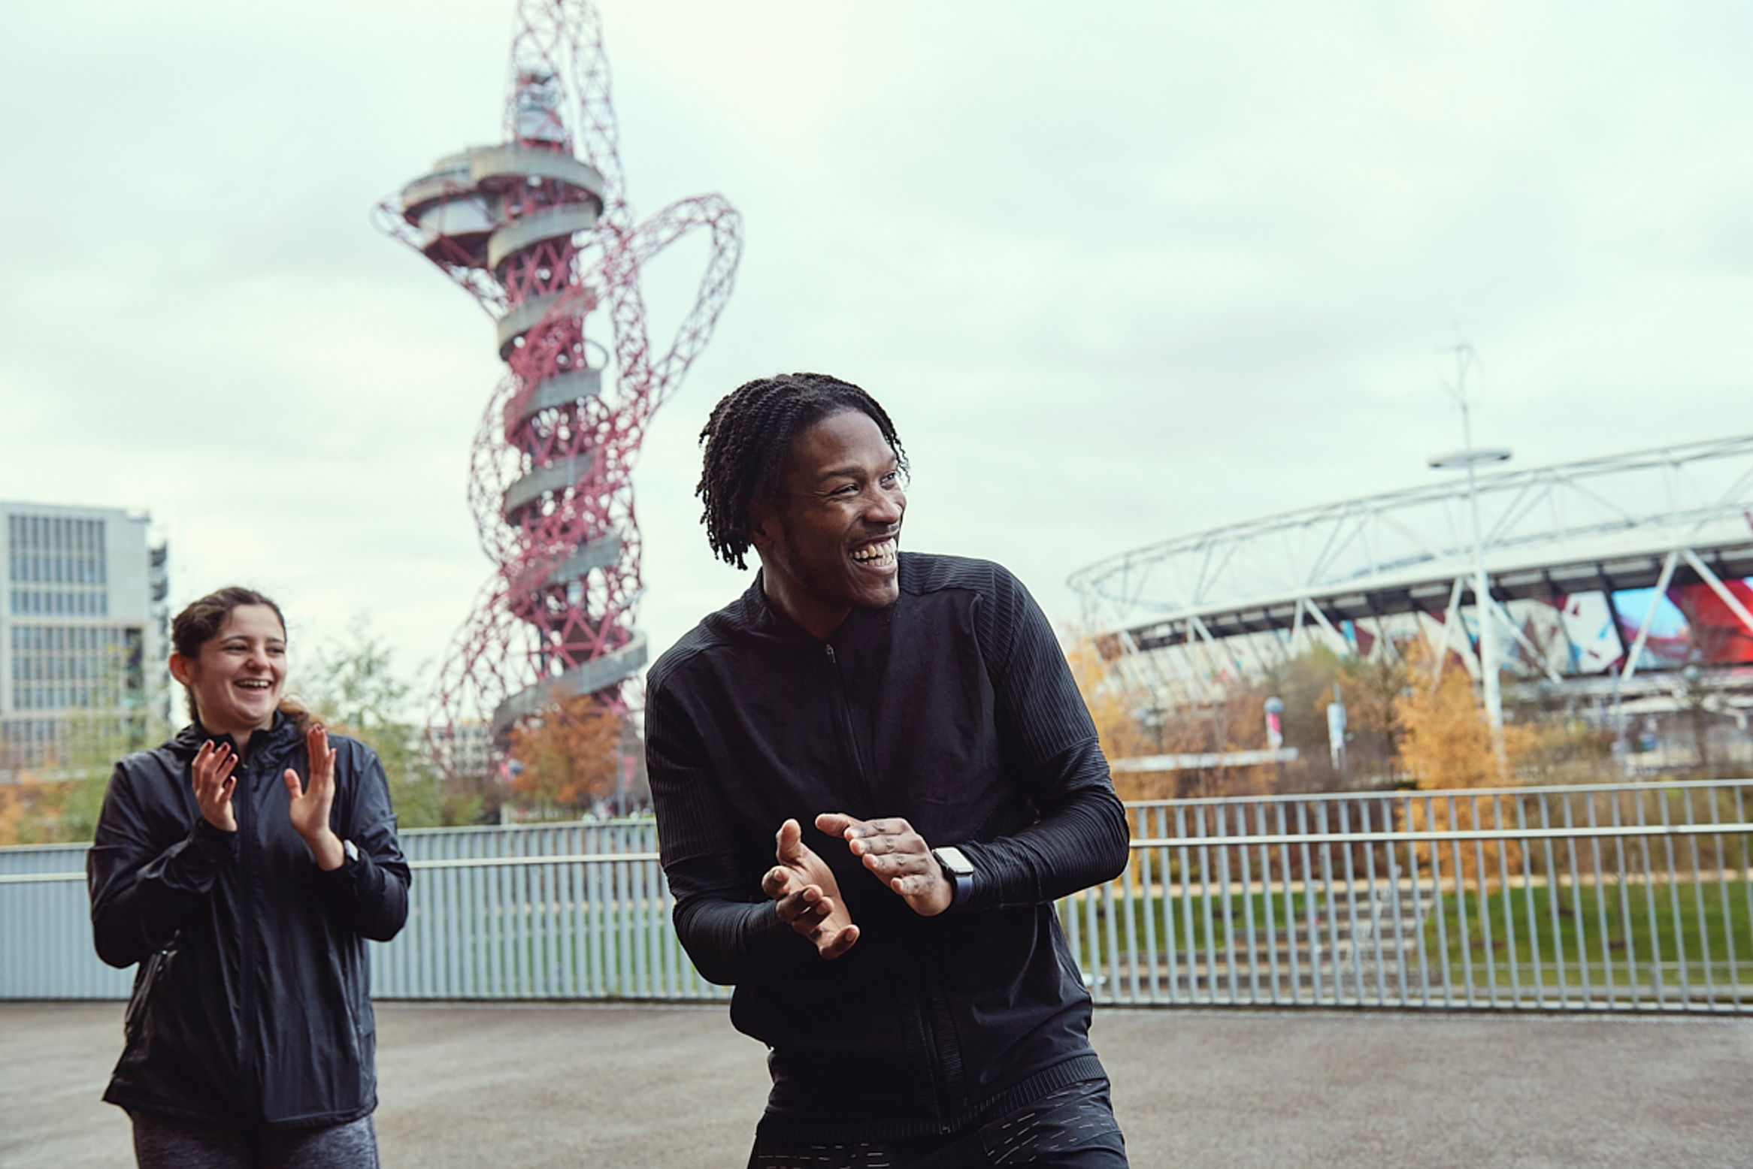
Thank you!
Buddle.co
Notes:
Title box: Click and drag the title box to resize, to allow for longer headings, or to fit around important areas of the image.
Image: To change the image, Right click / Control click on the image, select ‘Change picture… from file’.
Changing colours: Select the colour border area and apply a new shape fill from the Sport England Theme colours (please do not use the tints). Use the same colour for the border and the main title of the presentation.
Changing colours: Right click / control click the background, Select ‘Format background…’ Select a different fill colour from the Sport England Theme colours (please do not use the tints). Use the same colour for the border and the main title of the presentation.

