Slide 1





Financial management
Buddle.co

Slide 2



Use this doodle box to try the annotation tools whilst you wait.
You can find the annotation tools on the right of your screen
Welcome.
Your session will begin shortly.
Before we start, please ensure that:
If you are using social media, please tag: #Buddle, @SportEngland @SportStructures
Your microphone is muted
You can see and use the chat box
Buddle.co

Slide 3


A little about me…
… and you!
Add Tutor Picture
Add some info about you in the chat box:
- Your Club/Organisation Name
- Where you are based
- What would you like to gain from this workshop?
- Insert name
- Insert Experience
- My favourite …
Buddle.co

Slide 4

Learning Agreement
Respect everybody
Participate actively
Use technology responsibly
Be engaged
Challenge each other positively
Put phones on silent and return calls at an appropriate time
Avoid sharing any personal/sensitive information outside of the session
Buddle.co
Notes:
Please ask learners to consent to the delegate agreement using the chat box/mic etc
Participate actively - contribute to discussions and activities
Use technology responsibly - turning camera on, where possible, to build connections
Be engaged - limit distractions and maintain focus during the session

Slide 5
Learning Agreement
Respect everybody
Participate actively
Use technology responsibly
Be engaged
Challenge each other positively
Put phones on silent and return calls at an appropriate time
Avoid sharing any personal/sensitive information outside of the session
Buddle.co
Notes:
Please ask learners to consent to the delegate agreement using the chat box/mic etc
Participate actively - contribute to discussions and activities
Use technology responsibly - turning camera on, where possible, to build connections
Be engaged - limit distractions and maintain focus during the session

Slide 6
What we’ll cover:
By the end of this workshop, you will be able to:
Understand the importance of financial sustainability.
Understand the principles of good financial planning to aid financial sustainability.
Understand the principles of good financial management to aid financial sustainability.
Understand financial forecast budget, actual budget sheet and the variance sheet.
Buddle.co

Slide 7
What does financially sustainable mean to you?
“
Money in the bank
Diverse income streams
Financially self-sufficient
Effectively plan and manage their finances.
It feels like the organisation is stable and will be here in the long-term”
Buddle.co

Slide 8
We think sustainable organisations are…
People focused
Connected
Financially resilient
Buddle.co

Slide 9
What is the difference between...
Financial planning?
Financial management?
Income generation?
Buddle.co

Slide 10
What is the difference between...
Financial planning?
Forecasting – done by whole committee, inclusion from rest of the club sections, for example – juniors, under 25s, veterans, ladies. Linked to club development and business plan – at least a yearly forecast – consideration of medium- and long-term goals and a financial plan to match the club vision.
Financial management?
Budget management, yearly, quarterly and monthly with adjustments where necessary and consideration of risks to the budget and therefore the sustainability of the club.
Income generation?
Fundraising, grant applications, sponsorship, crowdfunding etc.
Is this more than one person in your club?
Buddle.co

Slide 11
Aspects to consider
Financial management
‘skilled driving’
Financial planning
‘the map’
Income Generation
‘servicing/oil/window wash etc.
Buddle.co

Slide 12
Setting financial goals for your group
Why do you need to do this?
Cash flow
Reducing debt
Liquidity (having enough money or assets to pay any money that is owed)
Cash reserves
Sinking fund – setting aside money for items that may need replacing or for a rainy day
Income revenue – increase year on year or a fundraising target
Diversify income streams
Return on investment – telling the story
Profit – set financial profit targets above actual cost to ensure a margin of safety
Buddle.co

Slide 13
Principles of good financial planning – ‘the map’
Governance
Roles and Responsibilities
Business Plan
Budget planning & cash flow
Risk management across all 4 areas
Buddle.co

Slide 14
Principles of good financial planning – ‘the map’
Business Plan
Is your financial planning informed by what your organisation is trying to achieve?
Does it complement your strategy and your business plan?
Risk management across all areas
Buddle.co

Slide 15
Principles of good financial planning – ‘the map’
Budget planning and cash flow
Do you set budgets?
Is there a short term (annual) and a long-term budget forecast?
Does your budget consider income and expenditure?
Have you predicted the monthly cash flow for the year ahead?
Is sufficient income set aside for reserves and contingency?
Risk management across all areas
Buddle.co

Slide 16

Could this situation happen to you?
How could you prevent it?
The treasurer has been taken ill and is long term care. No one else has access to the accounts and it is unclear how to access the deposit account to transfer money to different groups.
The main fundraising event of the year is a fete on the village green, the weather has been awful, and it may need to be cancelled. The organisation has already spent £2000 on fencing, a generator and supplies.
Saturdays has the greatest number of spectators and participants ready for an event, someone used to have a coffee and bacon roll stall making income for the organisation but hasn’t been able to run it the last 4 weeks. This income is needed to run the event and it may need to be cancelled until more funds are found.
Buddle.co

Slide 17
Setting/forecasting financial goals for your organisation examples
Income | Yearly total | Q 1 | Q2 | Q3 | Q4
Membership
Bar
Fundraising activities
Sporting events
Grants/sponsorship
Merchandise
Expenditure | Yearly total | Q 1 | Q2 | Q3 | Q4
Staff wages
Rent and service charges
Utilities
Insurance
Equipment
Sinking fund
Notes:
The budget sheets are in the link on the slide earlier – financial planning is forecasting and making decisions based on knowledge – for example – all the membership fees may come in q 1 – what the forecasting is doing is setting out the map for the club to follow – there maybe a fund raiser fete in the summer – what are the potential costs and potential or target profits for that? What will happen if it rains and the organisation has spent money and makes no profits? Is the event insured…
These are some examples – what examples does the group have on forecasting not on actual spend?

Slide 18
Principles of good financial planning – ‘the map’
Do you have a risk register set up?
Does the committee regular review possible financial risks?
How do you mitigate your potential financial risks?
Risk management across all areas
Buddle.co

Slide 19
Principles of good financial planning – ‘the map’
Roles and responsibilities
Is there a separate treasurer and fundraiser? Why does this matter?
Is the whole organisation/committee/trust involved in planning the finances?
Who does what in your current structure?
What do you need to address?
Risk management across all areas
Buddle.co

Slide 20
How financially healthy is your organisation?
How do you know?
Who else knows?
Financial management
‘skilled driving’
Buddle.co

Slide 21
Principles of good financial management
Budget monitoring
Up to date records
Transparency
Accounts
Roles and responsibilities
Buddle.co

Slide 22
Principles of good financial management
Risk management
Tax / VAT
Roles and responsibilities
Buddle.co

Slide 23
Principles of good financial management
Budget monitoring
https://www.sportenglandclubmatters.com/financial-management/financial-position-forecasting/budgeting/
Roles and responsibilities
Buddle.co

Slide 24
The following would be good practice:
Forecast by the governing committee on the yearly budget. Broken down in quarterly or monthly projections in all areas.
Budget holder/holders keep income and expenditure predictions or targets and then update monthly
Good budget holders will have a forecast (set by someone else), an actual and then a variance monthly allowing easy and transparent understanding of the budget against the forecast. All of these spreadsheets are available here:
https://www.sportenglandclubmatters.com/financial-management/financial-position-forecasting/budgeting/
Buddle.co

Slide 25
Setting/forecasting financial goals for your organisation examples
Income | M 1 | M 2 | M 3 | M4 | M5
Membership
Bar
Fundraising activities
Sporting events
Grants/sponsorship
Merchandise
Expenditure | M1 | M2 | M3 | M4 | M5
Staff wages
Rent and service charges
Utilities
Insurance
Equipment
Sinking fund
Notes:
The following would be good practice:
Forecast by the club/ committee on the yearly budget. Broken down in quarterly or monthly projections in all areas.
Budget holder/holders keep income and expenditure predictions or targets and then update monthly
Good budget holders will have a forecast (set by someone else), an actual and then a variance monthly allowing easy and transparent understanding of the budget against the forecast. All of these spreadsheets are available here:
https://www.sportenglandclubmatters.com/financial-management/financial-position-forecasting/budgeting/

Slide 26
Could this situation happen to you? How could you prevent it?
A team spends additional resources on equipment and facility hire without committee approval.
The Treasurer reports on the cash position only in committee.
All teams have bank accounts, and one team’s manager left the club with substantial funds.
A team event was affected by the weather and the club lost more money than they originally had.
The team spends weekly subscriptions money without recording it.
Buddle.co

Slide 27
Principles of good financial management
Transparency
Roles and responsibilities
Buddle.co

Slide 28
Principles of good financial management
Up to date records
Roles and responsibilities
Buddle.co

Slide 29
Principles of good financial management
Accounts
Roles and responsibilities
Buddle.co

Slide 30


Reflection
What will you take away from this session?
Any questions?
Please complete the evaluation
Good luck!
Buddle.co

Slide 31
Recap:
You should now be able to:
Understand the importance of financial sustainability.
Understand the principles of good financial planning to aid financial sustainability.
Understand the principles of good financial management to aid financial sustainability.
Understand financial forecast budget, actual budget sheet and the variance sheet.
Buddle.co

Slide 32
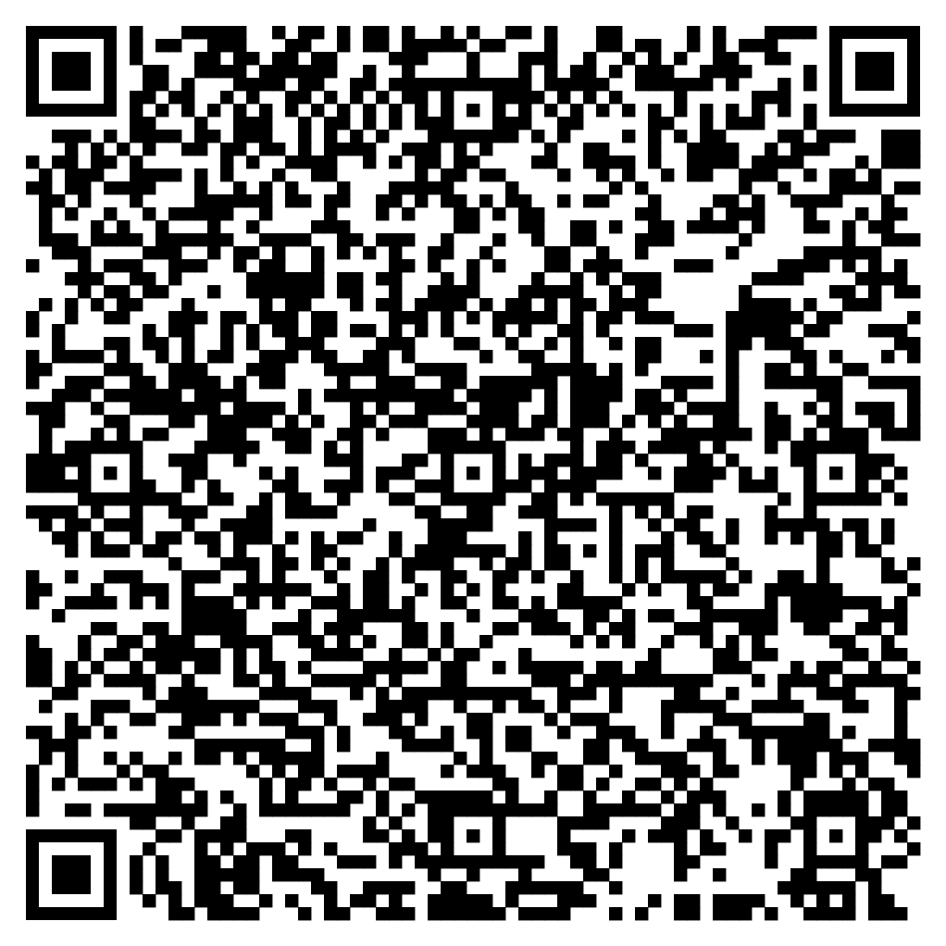





Feedback
Please take the time to fill in the evaluation survey by scanning the QR code.
Alternatively, the tutor will put the link in the chat box for you.
- Thanks in advance, the Buddle Team.

Slide 33

Buddle training
Getting Organised | Inclusion | Getting Help From People | Money Matters | Develop and Grow
Leadership and Your People | Your Culture and Values In Your Organisation | Maximising Your Volunteers Experience | Raising Money to Sustain Your Organisation | Promoting Your Offer Using Social Media
Exploring Legal Structures | Engaging different People |  | Financial Management | Creating a Marketing Strategy
Simply Planning | Positive Experiences For All People |  | Dealing With Increasing Costs | Engaging your community
See future dates at www.Buddle.co

Slide 34


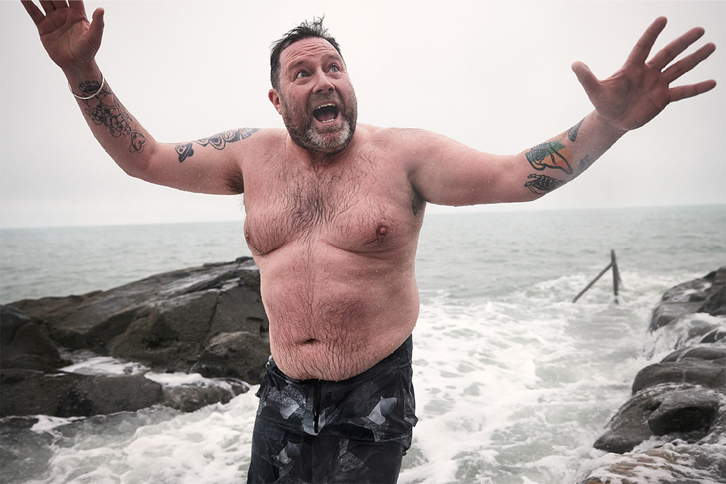
Thank you!
Buddle.co
Notes:
Title box: Click and drag the title box to resize, to allow for longer headings, or to fit around important areas of the image.
Image: To change the image, Right click / Control click on the image, select ‘Change picture… from file’.
Changing colours: Select the colour border area and apply a new shape fill from the Sport England Theme colours (please do not use the tints). Use the same colour for the border and the main title of the presentation.
Changing colours: Right click / control click the background, Select ‘Format background…’ Select a different fill colour from the Sport England Theme colours (please do not use the tints). Use the same colour for the border and the main title of the presentation.

