Slide 1





Creating a Marketing Strategy
Buddle.co

Slide 2



Use this doodle box to try the annotation tools whilst you wait.
You can find the annotation tools on the right of your screen
Welcome. Your session will begin shortly.
Before we start, please ensure that:
If you are using social media, please tag: #Buddle, @SportEngland @SportStructures
Your microphone is muted
You can see and use the chat box
Buddle.co

Slide 3


A little about me…
… and you!
Add Tutor Picture
Add some info about you in the chat box:
- Your Club/Organisation Name
- Where you are based
- What would you like to gain from this workshop?
- Insert name
- Insert Experience
- My favourite …
Buddle.co

Slide 4

Learning Agreement
Respect everybody
Participate actively
Use technology responsibly
Be engaged
Challenge each other positively
Put phones on silent and return calls at an appropriate time
Avoid sharing any personal/sensitive information outside of the session
Buddle.co
Notes:
Please ask learners to consent to the delegate agreement using the chat box/mic etc
Participate actively - contribute to discussions and activities
Use technology responsibly - turning camera on, where possible, to build connections
Be engaged - limit distractions and maintain focus during the session

Slide 5
What we’ll cover:
By the end of this workshop, you will be able to:
Understand the key principles of a marketing strategy
Describe how to develop a marketing strategy using a simple framework
Identify different marketing channels to maximise exposure
Understand how to effectively monitor and evaluate their marketing strategy.
Buddle.co

Slide 6
Marketing and why it’s useful to plan
What does marketing mean to you?
Do you have a marketing strategy?
Why do you need one?
Buddle.co

Slide 7
Marketing and why it’s useful to plan
A marketing strategy is:
“A plan of what, how and to whom you are going to market your organisation”
Benefits of having a marketing strategy:
Makes sure you are targeting the right people, at the right time, in the right way
Adds a framework & structure to what you do
Makes the most of your time and money
Enhances your organisation’s reputation.
Buddle.co

Slide 8
What’s your offer and what are your key messages?
Intro yourself and your organisation and pitch to the others when you are ready.
Elevator Pitch
Imagine you are stuck in an elevator, and asked about what your organisation offers....the person isn’t quite sure if they should join or not...
Sell your organisation in 30 seconds
Think about:
Imagine that they are a prospective new member, what would you say to them?
Why should they join?
How would your pitch be different for a different audience?
Buddle.co

Slide 9
A simple framework
In its simplest form, there are four major areas of focus to consider when developing a marketing strategy:
Key Messages
Identify market
Identify channels to communicate
Prepare organisation for new people
Market to the potential new people
Buddle.co

Slide 10
Aims of marketing activities
More members, volunteers, funders: What impact does your marketing have?
Reach and frequency: How many and how often individuals are exposed to your marketing message?
Awareness and perception: To what extent do members/potential members/funders/volunteers know about your organisation?
Cost: How much are you spending on marketing techniques and what return are they demonstrating?
Buddle.co

Slide 11
Who do you want to attract?
Participants & members
Coaches & officials
Volunteers
Sponsors
Funders
Fund raisers
Buddle.co

Slide 12
Who are your target market and what are the key messages?
How have you established who you are marketing to?
Are they different for participants, volunteers, sponsors or funders?
Who are your target market:
Participants
Volunteers
Sponsors
    What are the key messages that best describe your organisation’s offer.
    Friendly community organisation
    Competitive opportunities
    Open to all
    A professionally run organisation who will attract and develop high potential youths, by offering top level coaching and competition.
How best can you describe your organisation?
Buddle.co

Slide 13
How are you getting to people who don’t normally come to your sessions?
How do you identify your members and who are you missing?
1. Identify your demographic profile:
Age
Gender
Ethnicity
Socio-economic disadvantaged backgrounds:
2. Find out your local demographic profile and does your organisation reflect that?
3. Do you want to start new teams, start a women's section?
4. What are the best channels to use to get to new types of people?
Buddle.co

Slide 14
Marketing channels – which do you use?
Social media
Word of Mouth
Organisation website
Piggyback marketing
Events
Press and media
Leaflets, posters and newsletters
Buddle.co

Slide 15
Social Media – Do’s and Don’ts
Do | Don’t
Be yourself, be original Disclose who you represent Participate regularly Be human and have fun (but remember it is a public record) Give credit to others Include links, photos and videos to keep things interesting Be friendly and show personality through your content Share business milestones – like you would with family / friends | Hog the spotlight– think 90% about others / big ideas / resources and 10% about you Share / retweet without knowing what you are “endorsing” Post too much – spamming people will turn people off Not post enough – try several times a week or daily: keeps interest Ignore it – your customers may well already be talking about you Just focus on the business and push out business content.
Buddle.co

Slide 16







What is the best way to reach your target market?
88% of 18-29 year olds use Facebook
84% of 30-49 year olds use Facebook
72% of 50-64 year olds use Facebook
62% of 65+ year olds use Facebook
59% of 18-29 year olds use Instagram
33% of 30-49 year olds use Instagram
18% of 50-64 year olds use Instagram
8% of people 65+ use Instagram
36% of 18-29 year olds use X (formerly Twitter)
23% of 30-49 year olds use X
21% of 50-64 year olds use X
10% of 65+ year olds use X
Buddle.co

Slide 17
Working with the Media and Social media
Is the story topical, timely and relevant?
Is there a photo opportunity?
What is unusual or even more unique about this story?
Real news is all about people - news is created by and affects people.
Top tips:
Put the headline in the subject box of an email
Keep it short
Provide contact details
Follow up with a phone call
Buddle.co

Slide 18
Piggyback Marketing
Piggyback Marketing is when two or more organisations promote one another’s complementary (but non competing) products or services.
As a sports organisation you may consider engaging with your target market, piggybacking through the following different methods:
Use national or international events – Olympics
Use National marketing campaigns – This Girl Can
Visit schools, colleges and universities, community groups, local leisure centres, health organisations or local businesses.
Buddle.co

Slide 19

This girl can – Piggyback marketing
Buddle.co

Slide 20
Sponsorship/partnership
Sponsorship is a two way thing. In return for funding or services, you need to be able to provide value to the sponsor.
What you can offer them?
Logos printed on your: Kit, equipment, minibus, sideline banners
Their logo on your: website, email headers/ footers, Letter heads
Mention the company name in any events, team publicity, and end of season reports
Hold an event under the name of the sponsor: E.g.: “The Generous Pub Co. Cup”
Hold an event at your sponsor’s venue
What they can offer you?
Finance- in return for promotion
Kit, with their logo or company colours
Discounts e.g. money off equipment or supplies ordered from a specific shop, a reduced admission price to events when taking all of your organisation or society along, or a discount when hiring specific services or facilities
Facilities or a venue to host events.
Buddle.co

Slide 21
Developing a plan
Outline who needs to do what when
 | Responsible person | J | F | M | A | M | J | J | A | S | O | N | D
Plan – USP and target audience | XX
Engage members and committee through surveys and forums | XX
Are there links to outside influences – Mental health day, women’s world cup, Olympic games… | XX
Consider messages and pictures – online, within the organisation and through members | XX
Launch timely initiative | XX
Evaluate impact | XX
Ongoing marketing media. | XX
Buddle.co

Slide 22
Exercise - actions for your organisation
What are the key marketing actions you have for your organisation?
Buddle.co

Slide 23
Top tips
Ensure you have a plan for your marketing activity. It will make you more effective
Use the marketing mix to evaluate your offer
Make your objectives SMART
Different channels work for different people – you don’t have to use them all
Use people strengths. E.g. get someone who understands social media if you want to use it effectively
Work out how you are going to monitor how successful your marketing is. If it’s not working, don’t be afraid to change.
Buddle.co

Slide 24


Reflection
What will you take away from this session?
Any questions?
Please complete the evaluation
Good luck!
Buddle.co

Slide 25






Feedback
Please take the time to fill in the evaluation survey by scanning the QR code.
Alternatively, the tutor will put the link in the chat box for you.
- Thanks in advance, the Buddle Team.

Slide 26
Recap:
By the end of this workshop, you will be able to:
Understand the key principles of a marketing strategy
Describe how to develop a marketing strategy using a simple framework
Identify different marketing channels to maximise exposure
Understand how to effectively monitor and evaluate their marketing strategy.
Buddle.co

Slide 27


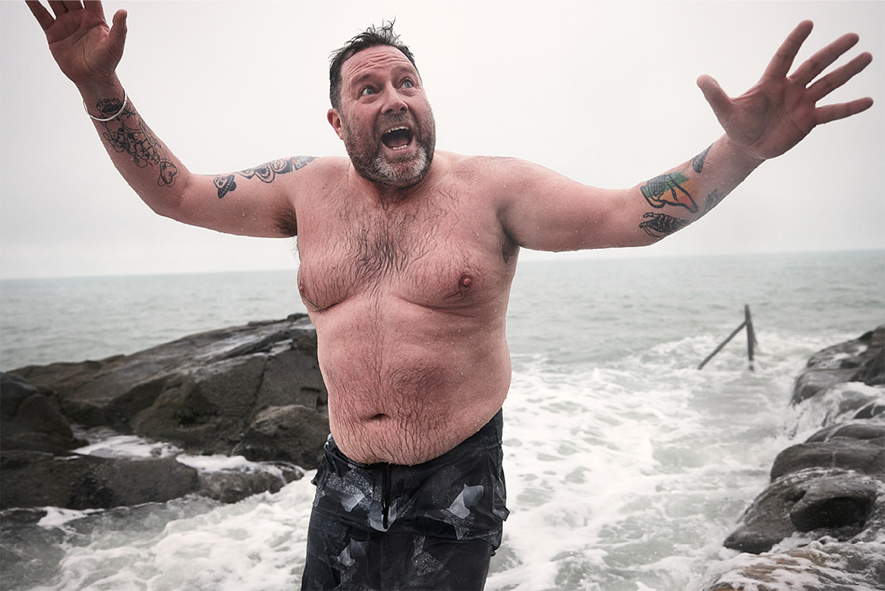
Thank you!
Buddle.co
Notes:
Title box: Click and drag the title box to resize, to allow for longer headings, or to fit around important areas of the image.
Image: To change the image, Right click / Control click on the image, select ‘Change picture… from file’.
Changing colours: Select the colour border area and apply a new shape fill from the Sport England Theme colours (please do not use the tints). Use the same colour for the border and the main title of the presentation.
Changing colours: Right click / control click the background, Select ‘Format background…’ Select a different fill colour from the Sport England Theme colours (please do not use the tints). Use the same colour for the border and the main title of the presentation.

