Slide 1





Future Planning
Buddle.co

Slide 2



Use this doodle box to try the annotation tools whilst you wait.
You can find the annotation tools on the right of your screen
Welcome.
Your session will begin shortly.
Before we start, please ensure that:
If you are using social media, please tag: #Buddle, @SportEngland @SportStructures
Your microphone is muted
You can see and use the chat box
Buddle.co

Slide 3


A little about me…
… and you!
Add Tutor Picture
Add some info about you in the chat box:
- Your Club/Organisation Name
- Where you are based
- What would you like to gain from this workshop?
- Insert name
- Insert Experience
- My favourite …
Buddle.co

Slide 4

Learning Agreement
Respect everybody
Participate actively
Use technology responsibly
Be engaged
Challenge each other positively
Put phones on silent and return calls at an appropriate time
Avoid sharing any personal/sensitive information outside of the session
Buddle.co
Notes:
Please ask learners to consent to the delegate agreement using the chat box/mic etc
Participate actively - contribute to discussions and activities
Use technology responsibly - turning camera on, where possible, to build connections
Be engaged - limit distractions and maintain focus during the session

Slide 5
What we’ll cover:
By the end of this workshop, you will be able to:
Understand what constitutes a business plan, its value, function and who should be involved in the process
Begin developing a business plan using a simple framework
Describe how to structure an effective business plan to meet the needs of their organisation
Understand how to access further information to support business planning.
Buddle.co

Slide 6
Why Plan?
For you:
Clear goals and direction – shapes your thoughts
Identifies where to focus time and energy
Helps communicate your organisation plan within your organisation
Identifies weaknesses and opportunities
Motivates
Identifies the resources your organisation needs
Long term sustainability
Identified how your organisation will measure impact
Buddle.co

Slide 7
Why Plan?
For stakeholders (members, funders, sponsors etc):
Helps communicate your organisations plan
It tells the organisation story; past, present and future
Demonstrates business control over your organisation
Shows how your organisation will make a difference.
Buddle.co

Slide 8
What is a business plan?
Buddle.co

Slide 9
What is a business plan?
Is a decision-making tool
Sets out what actions you will use to implement your strategy and achieve your organisation objectives and vision
Spells out what needs to be done, by whom and by when
Focuses on how you are going to achieve rather than just what you are going to achieve.
Buddle.co

Slide 10
A simple framework
In its simplest form, there are four major areas of focus to consider when developing a business plan:
1
An appraisal of your organisation, internal and environment analysis
Where are we now?
2
Where do we want to be?
A vision of the future; your organisation’s objectives
3
How do we want to get there?
A framework for action
4
How do we know we are there?
Mechanisms for monitoring
Buddle.co

Slide 11
3 pillars of a successful plan
Activities
Finance
Management
Buddle.co

Slide 12
Where are we now?
Strengths:
What does your organisation do well?
Weaknesses:
What could your organisation improve?
Opportunities:
What could your organisation change for the better?
Threats:
What are the main threats to your organisation?
Internal
External
Buddle.co

Slide 13

SWOT - exercise
Undertake a SWOT analysis for your organisation
Think about:
What is the current position of your organisation?
What do you do really well? What are you known for?
What are the key limiting factors to you achieving your goals? How can you address these?
What about your organisation keeps you awake at night?
What are the local opportunities? Large school? New estate? Supportive local council? Supportive community?
Who are your competitors? Other organisations? Other sports? Other leisure activities?
Buddle.co

Slide 14


Where do you want to be? - Vision
A vibrant, healthy and progressive organisation that thrives on providing enjoyable tennis playing opportunities for all ages.
To provide a quality experience within a friendly and welcoming atmosphere.
To be the best community organisation within five miles of the organisation headquarters.
  The organisation will play at the highest level. To be the recognised performance organisation in our community as well as a clear pathway for your players to start and progress.
What do you want your organisation to look like in 5-10 year's time?
Buddle.co

Slide 15
Your vision
Set out a vision for your organisation that you believe in and are proud to share with your members
Buddle.co

Slide 16
Business plan themes
Sport delivery
Facilities
Financial
Commercial
Workforce
Objective: To provide competitive opportunities for all ages and genders
Strategy: Develop consistent competition and training programme
Objective: To meet facilities requirements for Level X within 3 years
Strategy: Target investment into facility development
Objective: To ensure the organisation is financially managed well
Strategy: Ensure management of the accounts to make sure all expenses are covered and an agreed surplus is met
Objective: To increase non membership revenues by 50%
Strategy: Focus on the off-the-pitch experience of families to encourage additional revenues
Objective: To ensure all roles have a responsible person
Strategy: Focus on the right people supporting the delivery and management of the organisation activity
For each plan you would then want to consider: Actions – Personnel – responsibilities - Timeframe
Buddle.co

Slide 17
Setting Your Objectives
What are your organisation’s goals for the next 3-5 years?
Think about:
Thinking and planning together as an organisation
Consider the different options and approaches your organisation could take
What research can you do to help your organisation select the right goals to turn into objectives and actions? E.g. member surveys
What did your SWOT analysis tell you?
What goals can help your organisation move closer to their vision?
What does your organisation need to consider in terms of Activity, Management and Finance?
Buddle.co

Slide 18
Where do you want to be? - Objectives
When developing objectives, they should be SMART:
Specific
Measureable
Achievable
Realistic
Timely
General:
Grow our membership
SMART:
Increase our junior membership by 20% over the next year
Buddle.co

Slide 19
Where do you want to be? – Objectives example
Underpinning part of the Vision:
The organisation will play at the highest level possible but always operate on a responsible and prudent financial basis and always for the benefit of our members.
Within the next 5 years the organisation’s objectives are:
Activity: For the first team to be playing in the _____ league in 2 years.
Activity: To provide an increase in coaching contact time by 50% to increase the skill level of players
Management: To have fully qualified (level 2) coaches available for all age groups to ensure quality consistent coaching for all our teams, and to facilitate our first team being made up of local players.
Financial: To achieve and annually maintain a financial surplus of at least 1 years estimated running costs.
Buddle.co

Slide 20
Agreeing Your Objectives
Turn your goals into the key objectives for your organisation
Think about:
Your research and SWOT
Consider the goals you have identified, which ones are priorities for the organisation for the next 3 years?
Which goals can become SMART objectives and therefore can become a reality?
Do they help achieve the organisations overall vision?
Buddle.co

Slide 21
Tell us your objectives…
Buddle.co

Slide 22
How do we get there? – Actions example
Example objective: To have fully qualified (level 2) coaches available for all age groups to ensure quality consistent coaching for all our teams, and to facilitate our first team being made up of local players.
____ to review current coaching methods and best practice, present to playing committee and organisation coaching policy to be agreed by January 2020.
____ to evaluate what current coaching resource (numbers and qualifications) we have and what we need in the long term by March 2020.
____ to produce coaching development plan. To be discussed and agreed by August 2020.
Buddle.co

Slide 23
Your actions
Discuss and develop the actions your organisation needs to achieve its objectives.
Think about:
What are the actions you need to focus on to turn your vision into reality and meet your objectives?
What is the first action you are going to undertake?
Who is going to be responsible for these actions?
How long will this action take and when will it be completed by?
What resources are required?
Have you considered the overlap with objectives in Management and Finance?
Buddle.co

Slide 24
Tell us your actions…
Buddle.co

Slide 25
Financial planning – things to consider
Your action plan should highlight the resources you require to implement actions
Extrapolate these into a budget sheet
Consider the existing resources of your organisation and where you have gaps
Identify how you are going to resource these funding gaps as a finance objective with designated actions
Consider sources of funding including grants and fundraising.
Buddle.co

Slide 26
How do you know you’re there ?
Agree regular time periods to review your business plan i.e. quarterly at committee meetings
Setting clear objectives and actions will help you identify if you have achieved them or not
Giving clear timescales on when actions need to be completed by
Hold people responsible for actions
Update your plan if and when things move.
Buddle.co

Slide 27
Things to consider
Tailor to your audience
Who will read it?
What do they want to know?
Clear messages
Can it be read and understood on its own?
Positive
Does it leave me with a good impression?
Logical
Does it flow and make sense?
Buddle.co

Slide 28
Who should be involved?
Those
involved in putting the plan into action
Don’t leave it up to one person!
NGBs / Active Partnerships
Management / Committees
Happiness
Self worth
Contentment
External Advisors
Members
Other staff / volunteers
with key skills
Buddle.co

Slide 29
Structure your plan
Detail to support the plan
Main body of plan
Summary
Appendices
Your vision and objectives
Action plan – how are you going to do it?
Financial plan
Where are you at?
Summary
Introduction & organisation description
Buddle.co

Slide 30
When do I use my plan?
Main agenda at Management/committee meetings
Regular reviews - as frequent as appropriate
AGM
When making key decisions
When applying for funding.
Your business plan is a living document
Buddle.co

Slide 31
Top tips
Start your planning early - time disappears faster than you think
Involve the right people and discuss the plan with affected parties
Don’t be afraid to change the plan if circumstances change radically, but also try to plan for changes
Set realistic and achievable targets; don’t make the plan over-optimistic
Get help where
Above all, create a business plan and use it regularly you need it.
Buddle.co

Slide 32


Reflection
What will you take away from this session?
Any questions?
Please complete the evaluation
Good luck!
Buddle.co

Slide 33
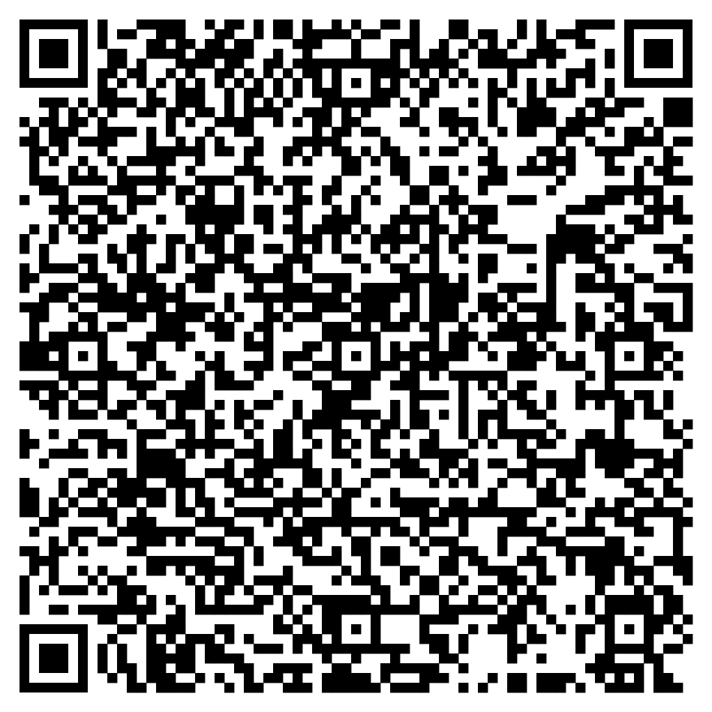





Feedback
Please take the time to fill in the evaluation survey by scanning the QR code.
Alternatively, the tutor will put the link in the chat box for you.
- Thanks in advance, the Buddle Team.

Slide 34
Recap:
By the end of this workshop, you will be able to:
Understand what constitutes a business plan, its value, function and who should be involved in the process
Begin developing a business plan using a simple framework
Describe how to structure an effective business plan to meet the needs of their organisation
Understand how to access further information to support business planning.
Buddle.co

Slide 35

Buddle training
Getting Organised | Inclusion | Getting Help From People | Money Matters | Develop and Grow
Leadership and Governance | Your Culture and Values In Your Organisation | Maximising Your Volunteers Experience | Raising Money to Sustain Your Organisation | Promoting Your Offer Using Social Media
Exploring Legal Structures | Engaging different People |  | Financial Management | Creating a Marketing Strategy
Future Planning | Positive Experiences For All People |  | Dealing With Increasing Costs | Engaging your community
See future dates at www.Buddle.co

Slide 36


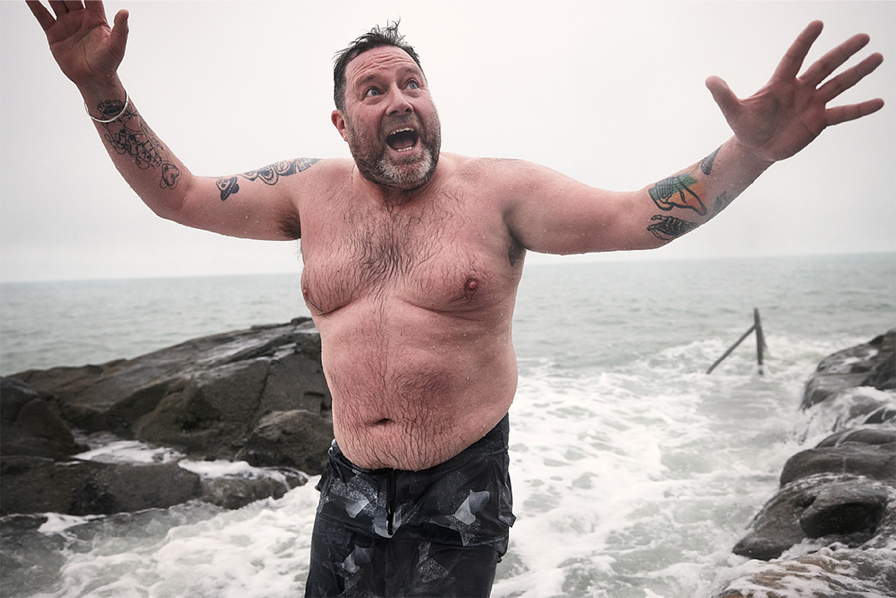
Thank you!
Buddle.co
Notes:
Title box: Click and drag the title box to resize, to allow for longer headings, or to fit around important areas of the image.
Image: To change the image, Right click / Control click on the image, select ‘Change picture… from file’.
Changing colours: Select the colour border area and apply a new shape fill from the Sport England Theme colours (please do not use the tints). Use the same colour for the border and the main title of the presentation.
Changing colours: Right click / control click the background, Select ‘Format background…’ Select a different fill colour from the Sport England Theme colours (please do not use the tints). Use the same colour for the border and the main title of the presentation.

